Slide 1
JSALT
Kenneth Church
May 9, 2023
https://github.com/kwchurch/JSALT_Better_Together

Slide 2
Readings: Before May 14 https://github.com/kwchurch/JSALT_Better_Together/tree/main/examples/near/reading_list
https://huggingface.co/allenai/specter
https://github.com/allenai/scirepeval
https://www.ijcai.org/proceedings/2019/0594.pdf (Prone Paper)
https://arxiv.org/pdf/2103.09430.pdf (OGB-LSC Paper; KDD Cup)
https://arxiv.org/pdf/1709.07604.pdf (Survey)

Slide 3
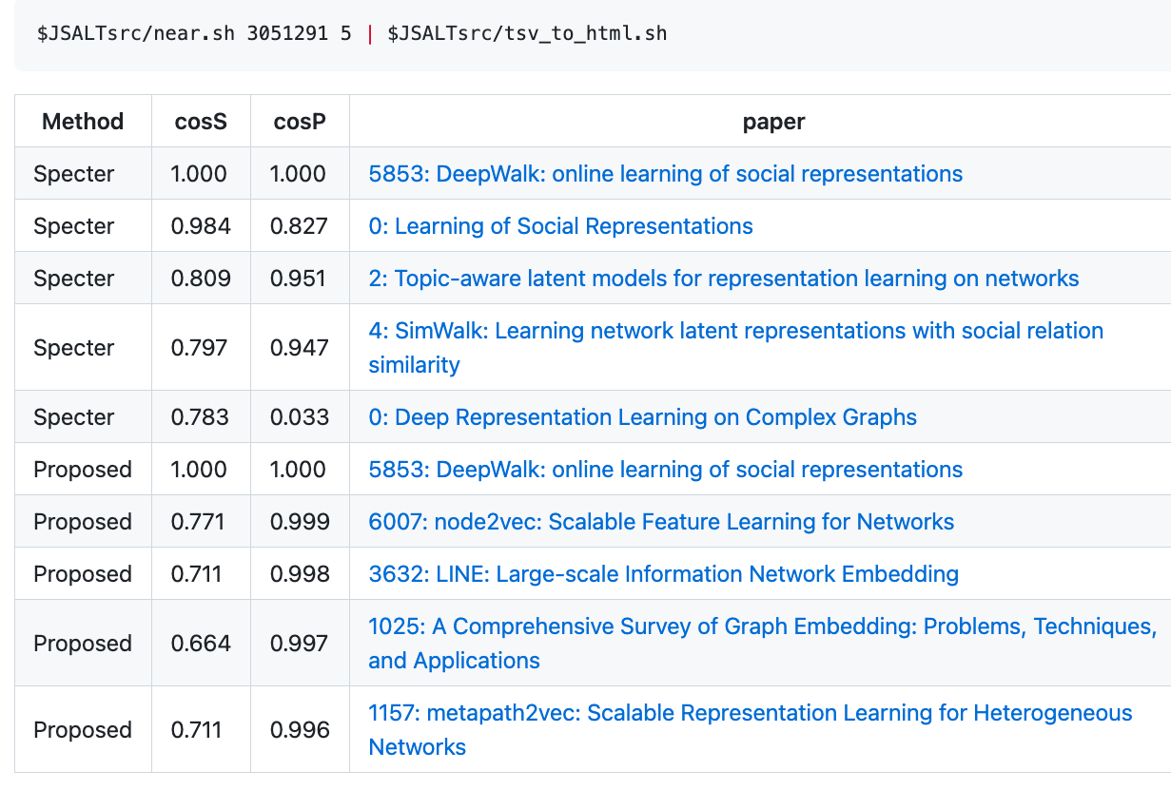
https://github.com/kwchurch/JSALT_Better_Together

Slide 4
Pointers to Code based on ANN https://github.com/kwchurch/JSALT_Better_Together
Environment variables
query=232040593
JSALTdir=/work/k.church/JSALT-2023/
JSALTsrc=/work/k.church/githubs/JSALT_Better_Together/src
specter=$JSALTdir/semantic_scholar/embeddings/specter
proposed=$JSALTdir/semantic_scholar/embeddings/proposed
Find 5 papers near query (using both Specter and Proposed)
$JSALTsrc/near.sh $query 5
Under the covers
# Find 10 papers near query (using specter embedding)
echo $query | $JSALTsrc/C/near_with_floats --dir $specter $specter/map $specter/idx.*.i > /tmp/near.specter
cut -f1,3 < /tmp/near.specter | sort -nr -u | head
# Same as above, but replace specter embedding with proposed embedding
echo $query | $JSALTsrc/C/near_with_floats --dir $proposed $proposed/idx.*.i > /tmp/near.proposed
cut -f1,3 < /tmp/near.proposed | sort -nr -u | head

Slide 5
Deliverables
Better access to literature
Resources:
Many embeddings for many papers
More models to be posted on HuggingFace
Code to be posted on GitHub
Methods to compare and contrast across small (and large) collections of documents
Support incremental updates to embeddings based on citation graphs
Evaluation: Better numbers, as well as better benchmarks
Establish that combinations of text and links are better together (than either by itself)
Establish that citing sentences are useful
Improve methods for assigning papers to reviewers
Theory: Unified framework of deep nets and Linear Algebra

Slide 6
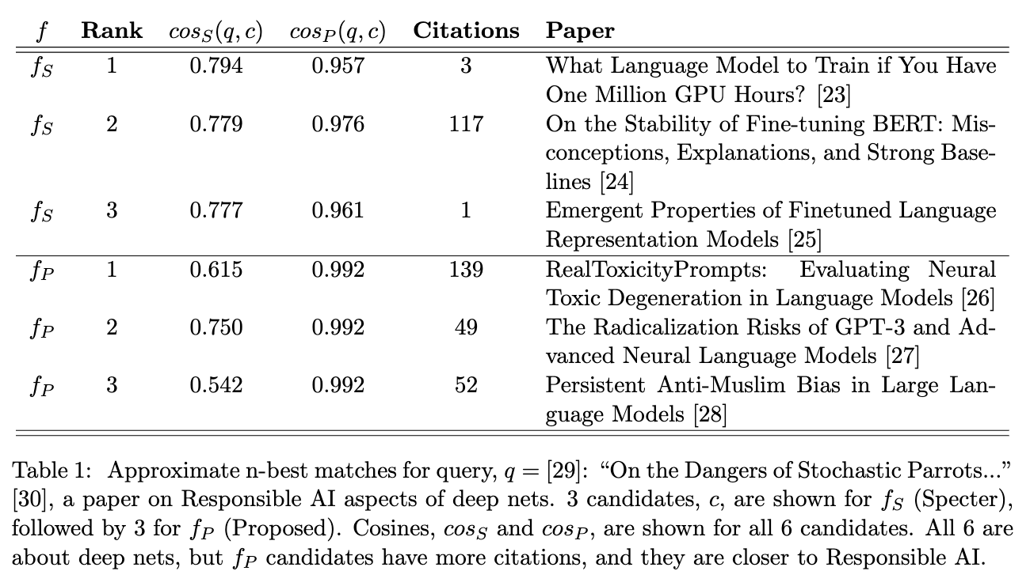
Example of Rank Retrieval

Slide 7
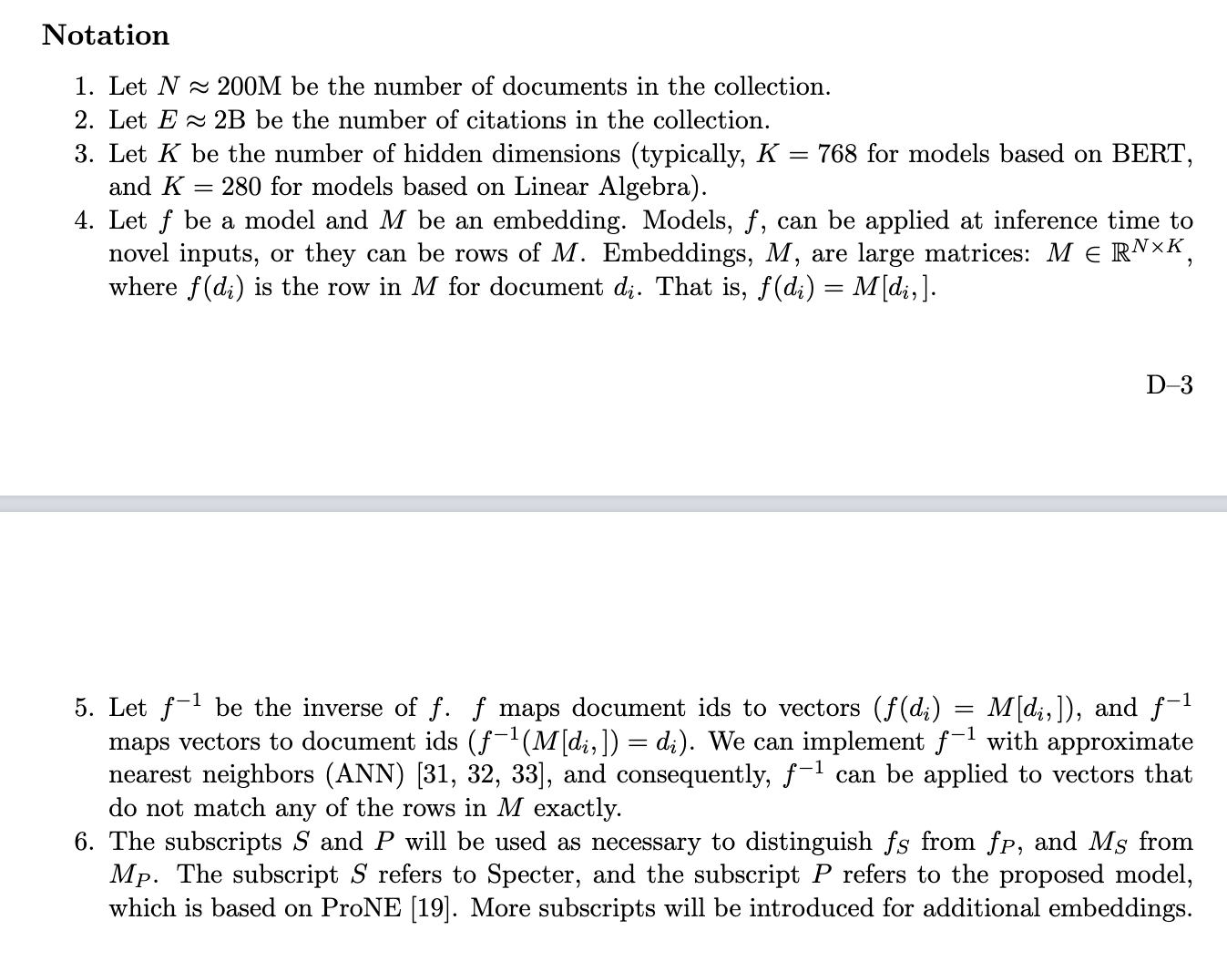

Slide 8
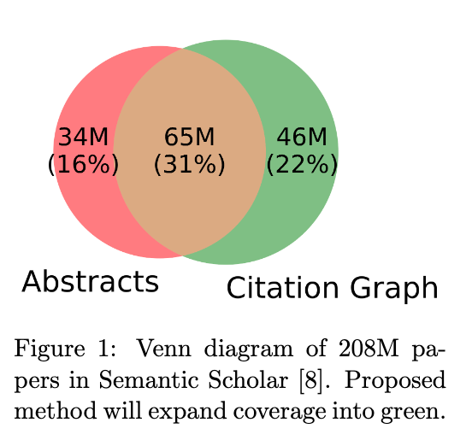
Missing Abstracts
Challenge: Missing and/or Corrupted Features

Slide 9


Rank | Specter | Proposed | Paper
query | 1.000 | 1.000 | 1097: On stress and linguistic rhythm
1 | 0.908 | 0.926 | 0: Linguistic Society of America Structure and Intonation
2 | 0.895 | 0.977 | 475: Preliminaries to linguistic phonetics
3 | 0.885 | 0.921 | 25: Linguistic Society of America On the Definition of Word by
4 | 0.881 | 0.763 | 37: On some defferences between Chinese and Japanese '-Wh'-elements
5 | 0.880 | 0.946 | 2: Some accentuation properties in Japanese and lexical phonology
6 | 0.865 | 0.824 | 6: Two Types of Zi-Verbs in Japanese
7 | 0.777 | 0.097 | 15: The Value of Natural Sounds
8 | 0.766 | 0.089 | 16: Re-Examining the Foundations
9 | 0.757 | 0.106 | 8: Facts and Faith in Biblical History
1 | 0.578 | 0.998 | 226: The phonology of rhythm in English
2 | 0.530 | 0.997 | 74: A grid-based theory of English meter
3 | -1.000 | 0.996 | 5: "What does Phonology tell us about Stress and Rhythm? Some Reflections on the Phonology of Stress"
4 | 0.460 | 0.994 | 1: Syllable structure and stress in Bahdinani Kurdish
5 | 0.442 | 0.994 | 35: Schwa in phonological theory
6 | -1.000 | 0.994 | 163: The Sound Pattern of Russian: A Linguistic and Acoustical Investigation
7 | 0.542 | 0.993 | 27: Empirical evidence for a deletion formulation of the rhythm rule in English
8 | 0.552 | 0.993 | 95: Prosodic Structure Above the Word
9 | 0.334 | 0.993 | 0: Syllable Contraction in Cantonese A-not-A Constructions: An Optimality Account

Slide 10
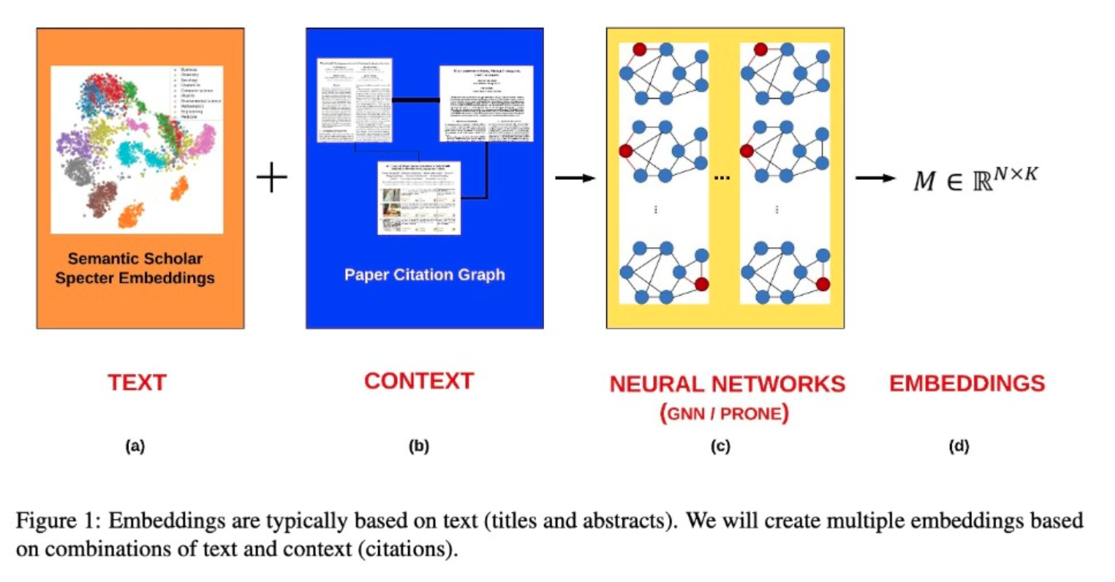

Slide 11
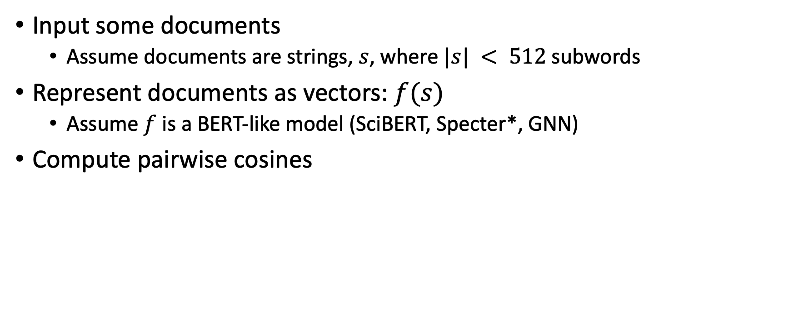
Inference Exercise: Document Similarity
Input some documents
Assume documents are strings, $s$, where $|s| < 512$subwords
Represent documents as vectors: $f(s)$
Assume $f$ is a BERT-like model (SciBERT, Specter*, GNN)
Compute pairwise cosines

Slide 12
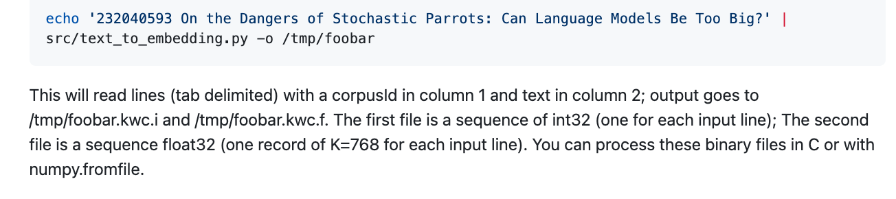
text_to_embedding.py https://github.com/kwchurch/JSALT_Better_Together

Slide 13
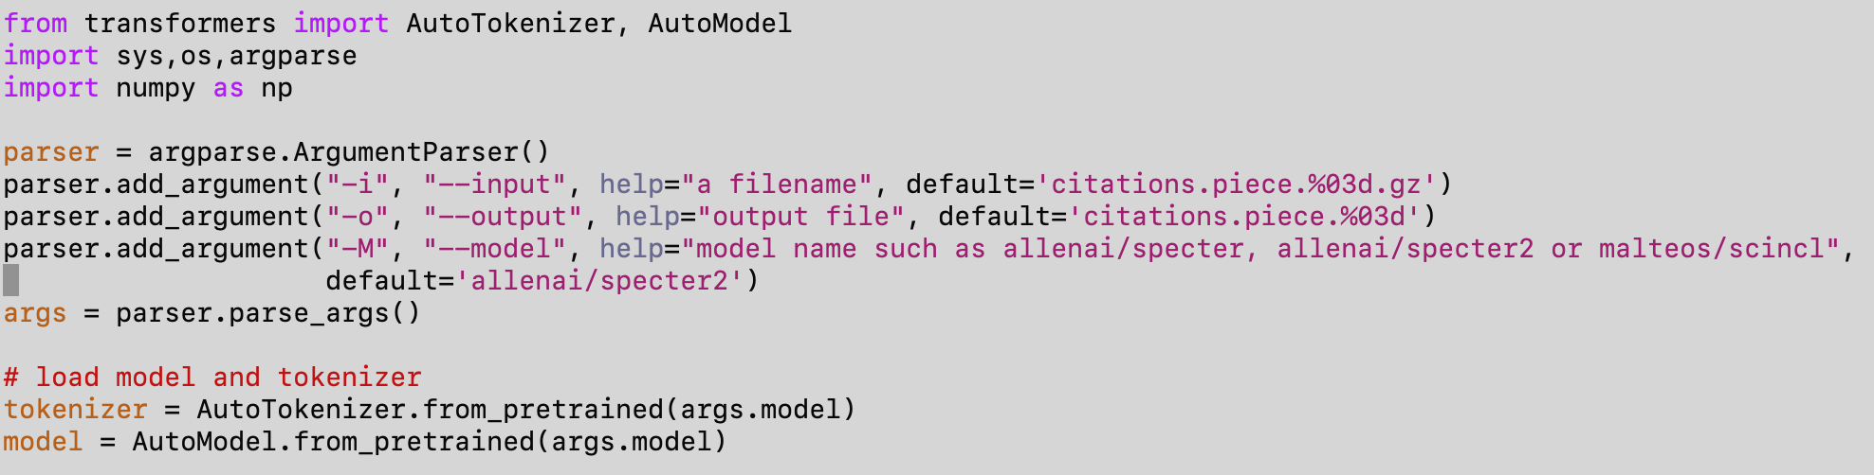
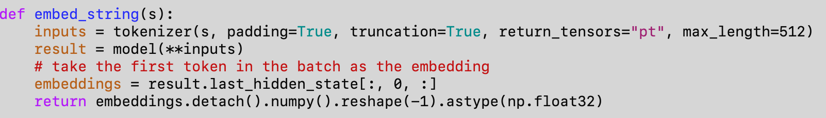

Inference: $f(s)$ → vector of 768 floats https://github.com/kwchurch/JSALT_Better_Together/blob/main/src/text_to_embedding.py

Slide 14
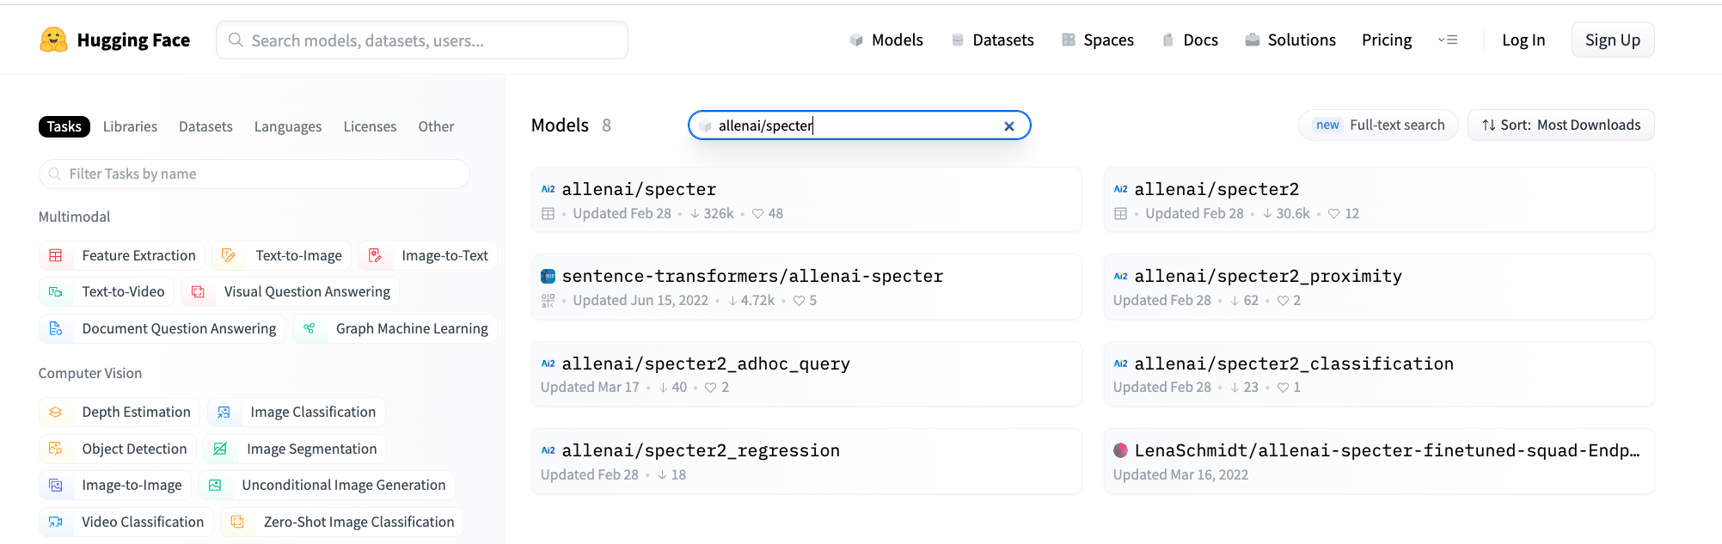
https://huggingface.co/models?sort=downloads&search=allenai%2Fspecter

Slide 15
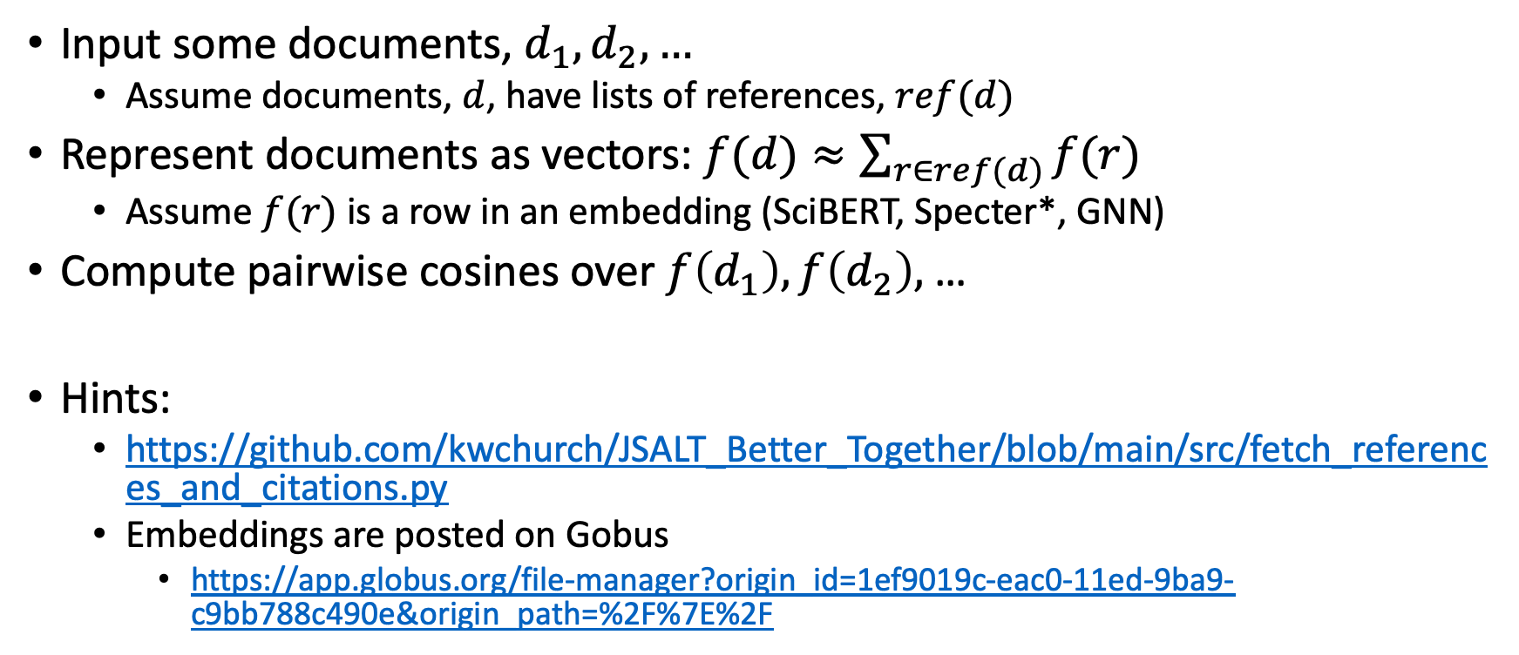
Inference Exercise 2: Document Similarity (but use references instead of titles)
Input some documents, $d_{1},d_{2},…$
Assume documents, $d$, have lists of references, $ref(d)$
Represent documents as vectors: $f(d)≈\sum_{r∈ref(d)}{f(r)}$
Assume$f(r)$ is a row in an embedding (SciBERT, Specter*, GNN)
Compute pairwise cosines over $f\left(d_{1}\right), f\left(d_{2}\right),$…
Hints:
https://github.com/kwchurch/JSALT_Better_Together/blob/main/src/fetch_references_and_citations.py
Embeddings are posted on Gobus
https://app.globus.org/file-manager?origin_id=1ef9019c-eac0-11ed-9ba9-c9bb788c490e&origin_path=%2F%7E%2F

Slide 16
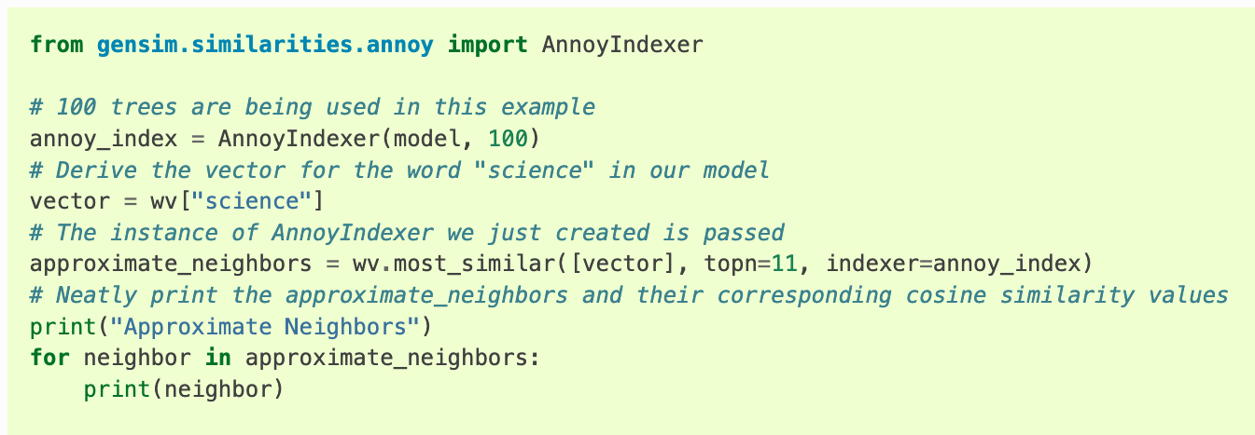
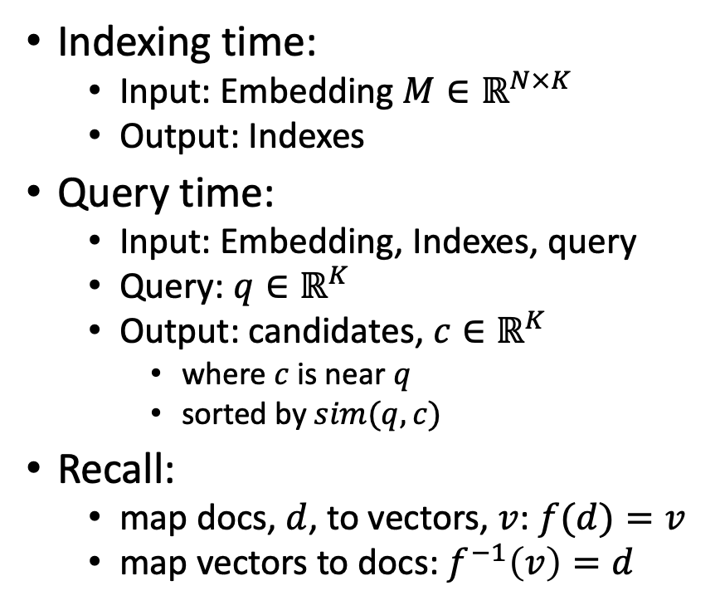
Processing with Embeddings: Annoy / Faiss Approximate Nearest Neighbors (ANN)
Indexing time:
Input: Embedding $M∈ℝ^{N×K}$
Output: Indexes
Query time:
Input: Embedding, Indexes, query
Query: $q∈ℝ^{K}$
Output: candidates, $c∈ℝ^{K}$
where $c$ is near $q$
sorted by $sim(q,c)$
Recall:
map docs, $d$, to vectors, $v$: $f(d)=v$
map vectors to docs: $f^{−1}\left(v\right)=d$
https://radimrehurek.com/gensim/auto_examples/tutorials/run_annoy.html

Slide 17
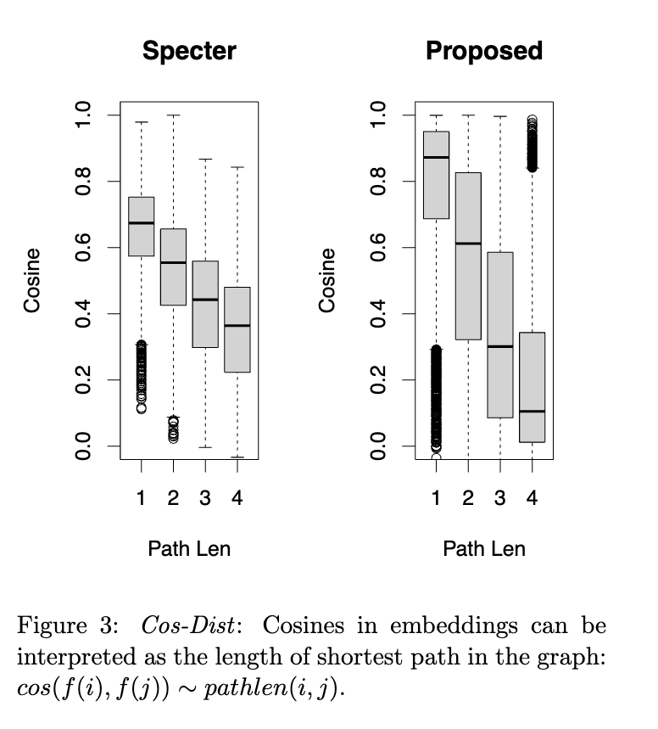
Multiple Representations
Speech:
Time Domain
Frequency Domain
Documents:
Citation Graphs
Embeddings
Operations
Filtering (speech):
Time: convolution
Freq: multiplication
Similarity (documents)
Graphs:
Random Walks
Embeddings:
Cosines
ANN (approximate nearest neighbors)

Slide 18

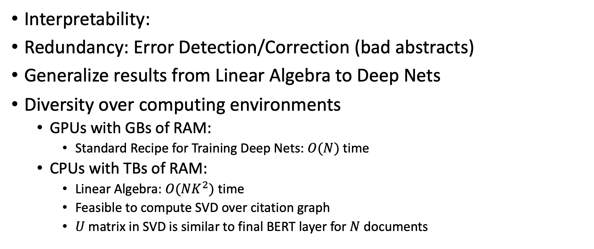
Advantages of Multiple Representations
Interpretability:
Redundancy: Error Detection/Correction (bad abstracts)
Generalize results from Linear Algebra to Deep Nets
Diversity over computing environments
GPUs with GBs of RAM:
Standard Recipe for Training Deep Nets: $O(N)$ time
CPUs with TBs of RAM:
Linear Algebra: $O(NK^{2})$ time
Feasible to compute SVD over citation graph
$U$matrix in SVD is similar to final BERT layer for $N$ documents

Slide 19
Agenda: Tutorial on Basic Background
GNNs: Fine-Tune BERT-like models with Graphs (Citations)
Challenge: Use citations at inference time
Semantic Scholar API
GitHub: https://github.com/kwchurch/JSALT_Better_Together
Deep Nets: Standard 3-step Recipe
Plug for ACL-2022 Tutorial (GFT = General Fine-Tuning)
Approximate Nearest Neighbors
Linear Algebra
Node2vec/ProNE

Slide 20


GNN Alternative
Black Box
GNN
Embeddings
$$M∈ℝ^{N×K}$$
Text
Context

Slide 21
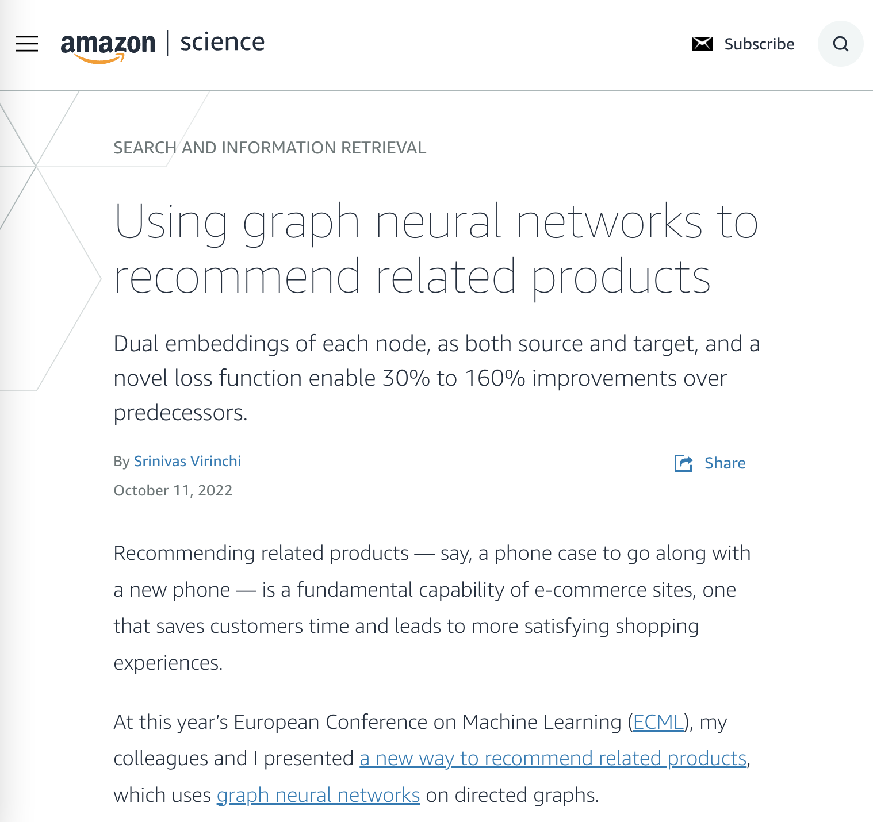
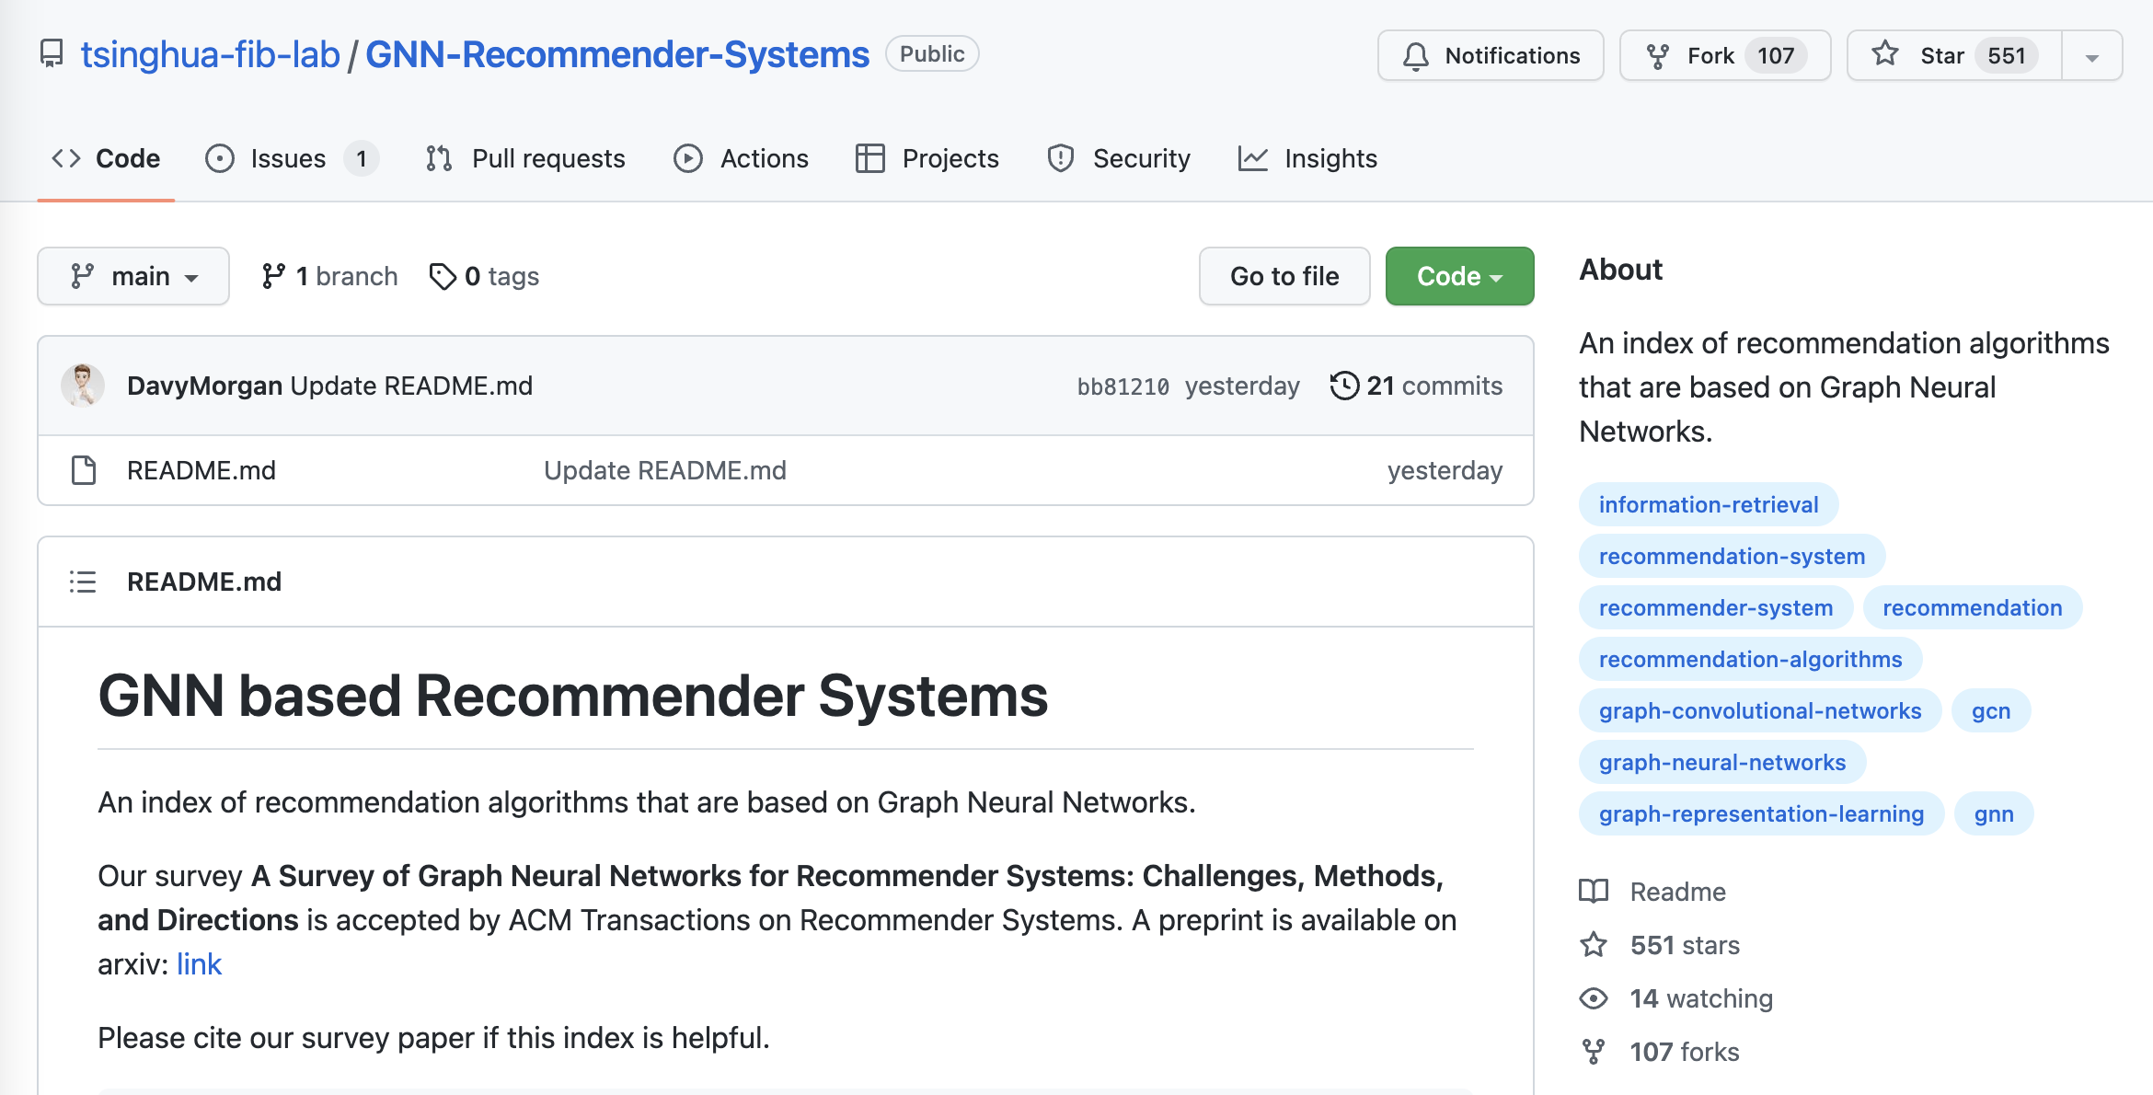
Why GNN?

Slide 22
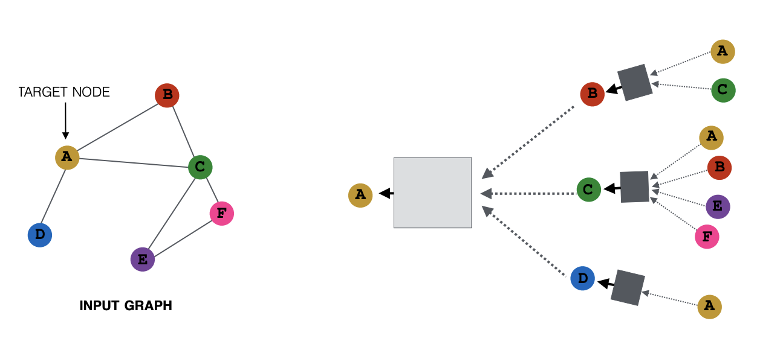

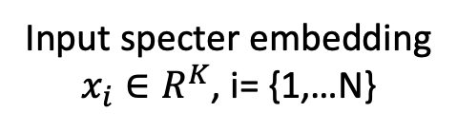

What is GNN?
Matrix Computation
Matrix Computation
Node (a paper): specter embedding
Edge: citation
Input specter embedding
$x_{i}∈R^{K}$, i= {1,…N}
Output embedding
$$x_{A}∈R^{f}$$
2-hop
Input Citation Graph
$G∈R^{N×N}$
1-hop
Ref: https://snap-stanford.github.io/cs224w-notes/machine-learning-with-networks/graph-neural-networks

Slide 23
Challenge Scale Data Parallelism v.s. Gsplit Parallelism
Proposed
Today’s data parallelism (e.g., DGL, PaGraph)
Proposed split parallelism (Gsplit)
Standard
Data parallelism – too much communication
Split parallelism (Proposed)

Slide 24
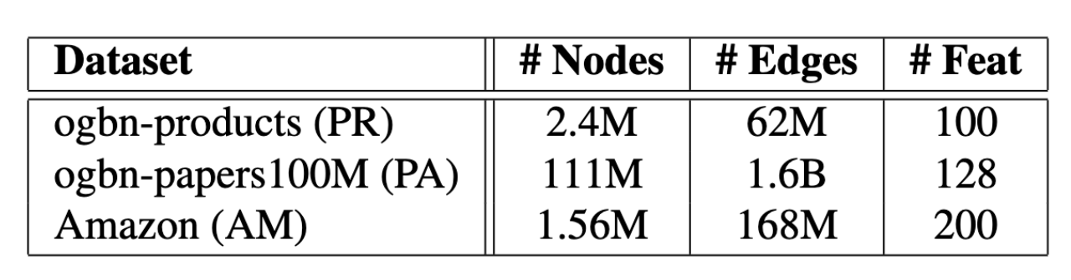
Gsplit is Faster
Today’s data parallelism (e.g., DGL, PaGraph)
Proposed split parallelism (Gsplit)

Slide 25
Agenda: Tutorial on Basic Background
GNNs: Fine-Tune BERT-like models with Graphs (Citations)
Challenge: Use citations at inference time
Semantic Scholar API
GitHub: https://github.com/kwchurch/JSALT_Better_Together
Deep Nets: Standard 3-step Recipe
Plug for ACL-2022 Tutorial (GFT = General Fine-Tuning)
Approximate Nearest Neighbors
Linear Algebra
Node2vec/ProNE

Slide 26
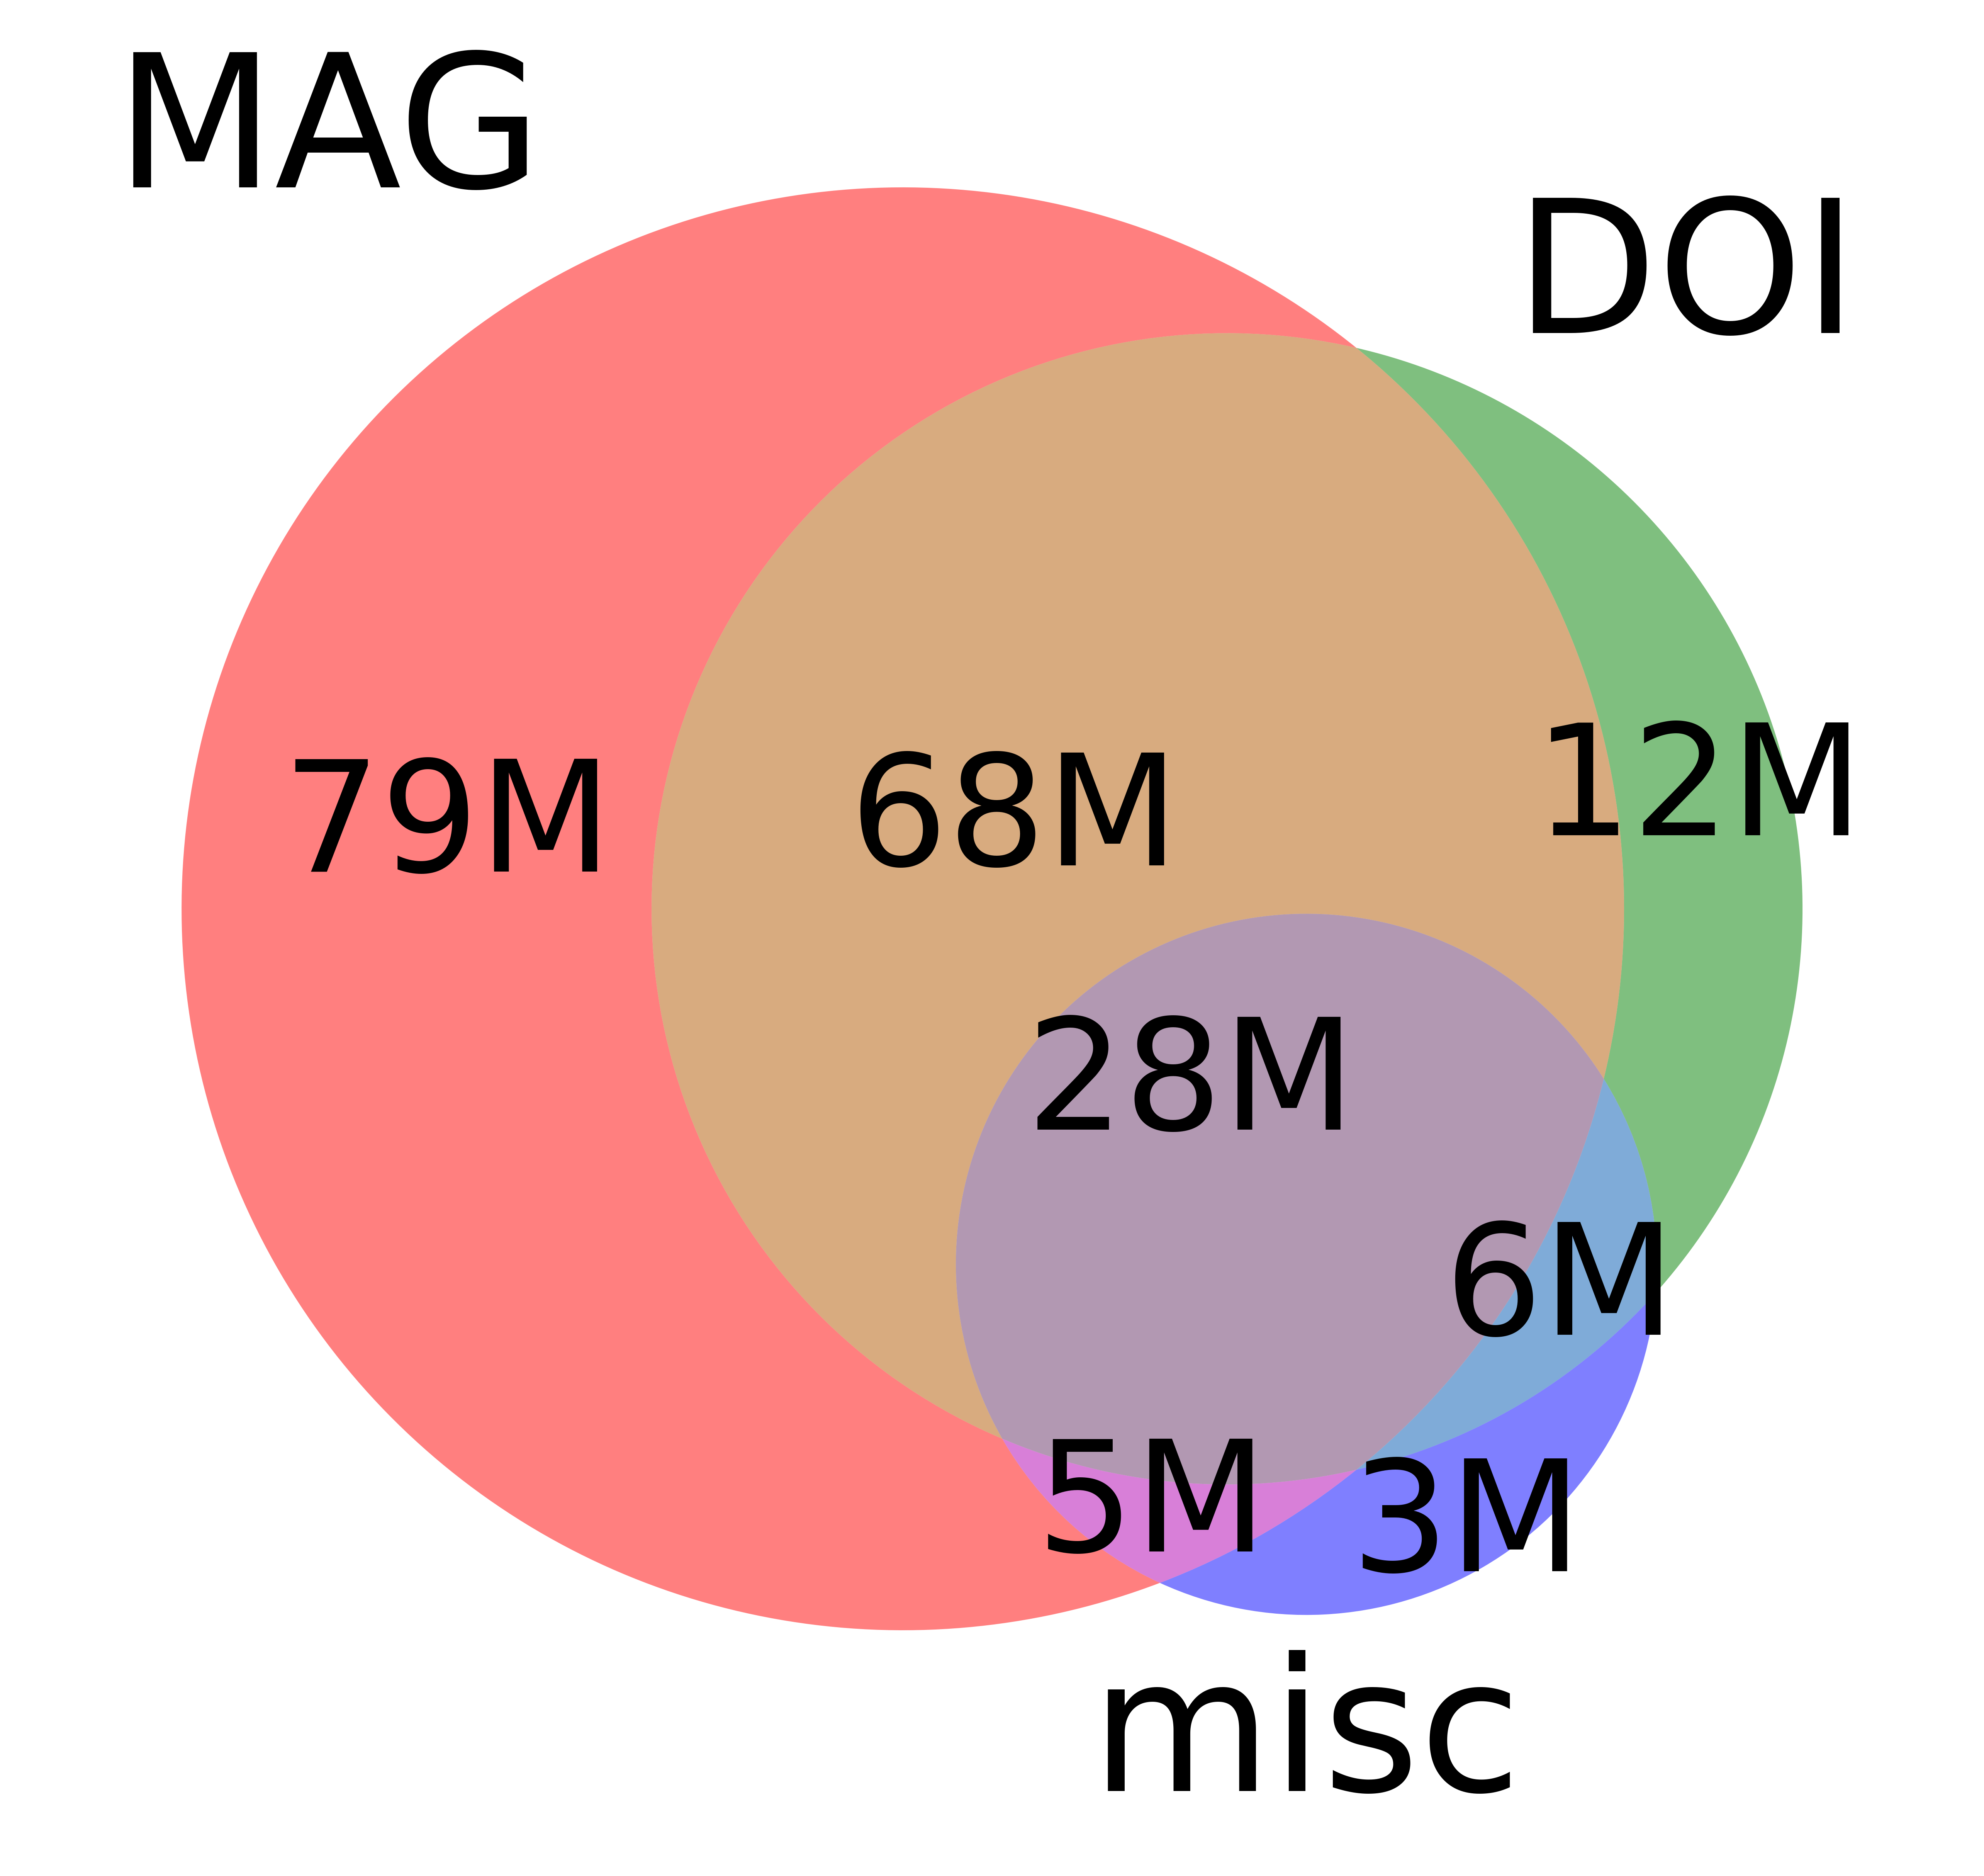
Sources for Papers in Semantic Scholar
 | Source | Papers (millions)
1 | CorpusId | 207.80
2 | MAG (Microsoft Academic Graph) | 182.18
3 | DOI | 113.54
4 | PubMed | 35.03
5 | DBLP | 6.06
6 | PubMedCentral | 4.86
7 | ArXiv | 2.15
8 | ACL | 0.08

Slide 27


Example of Semantic Scholar Page https://www.semanticscholar.org/paper/On-the-Dangers-of-Stochastic-Parrots%3A-Can-Language-Bender-Gebru/6d9727f1f058614cada3fe296eeebd8ec4fc512a https://github.com/kwchurch/JSALT_Better_Together/blob/main/src/fetch_from_semantic_scholar_api.py https://www.semanticscholar.org/product/api

Slide 28
Some useful fields (for papers) (API supports ad hoc queries as well as bulk downloads)
title
abstract
authors
externalIds
citationCount
referenceCount
citations
references
embedding (Specter 1)
venue
fieldsOfStudy
s2fieldsOfStudy
openAccessPdf
tldr

Slide 29
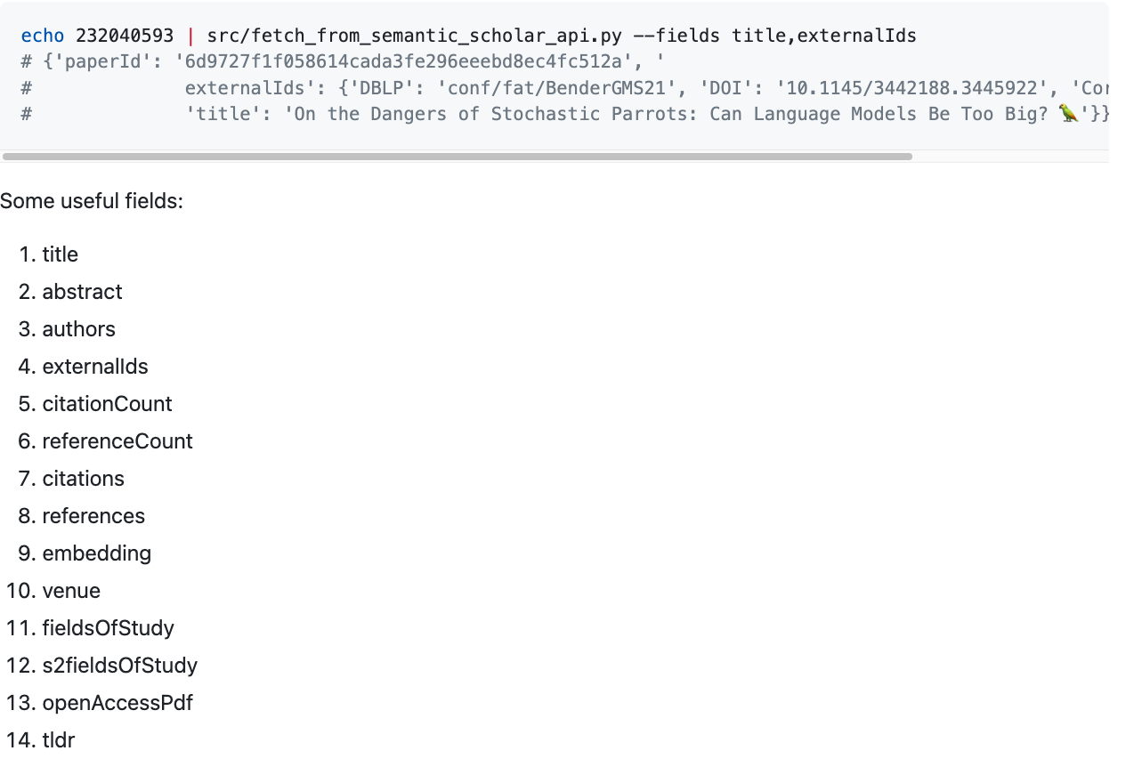
https://github.com/kwchurch/JSALT_Better_Together

Slide 30
Agenda: Tutorial on Basic Background
GNNs: Fine-Tune BERT-like models with Graphs (Citations)
Challenge: Use citations at inference time
Semantic Scholar API
GitHub: https://github.com/kwchurch/JSALT_Better_Together
Deep Nets: Standard 3-step Recipe
Plug for ACL-2022 Tutorial (GFT = General Fine-Tuning)
Approximate Nearest Neighbors
Linear Algebra
Node2vec/ProNE

Slide 31
Standard 3-step recipe
Pre-training
Fine-tuning
Inference

Slide 32
Standard 3-Step Recipe
Step | Description | Time | Hardware
1
2
3 | Inference | Seconds/Minutes | 0+ GPUs
Easy

Slide 33
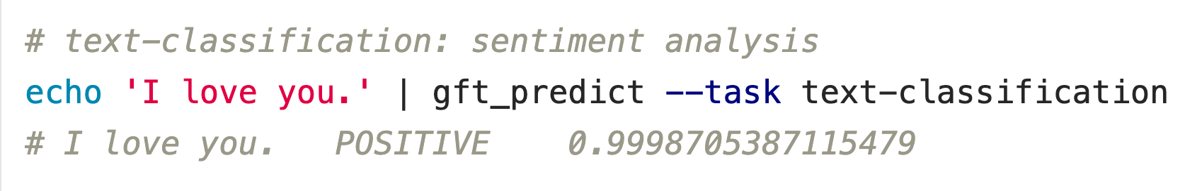


Inference: f(x) → y
Score
https://github.com/kwchurch/ACL2022_deepnets_tutorial

Slide 34



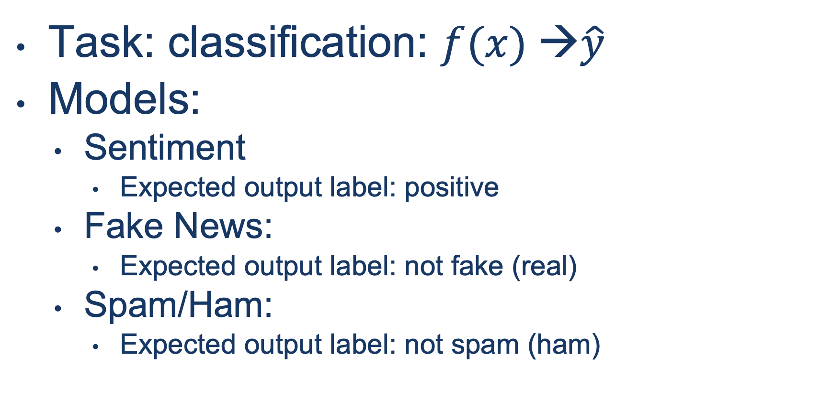
Input: I love you Output: Depends on Model: $f$
Task: classification: $f(x) →\hat{y}$
Models:
Sentiment
Expected output label: positive
Fake News:
Expected output label: not fake (real)
Spam/Ham:
Expected output label: not spam (ham)

Slide 35
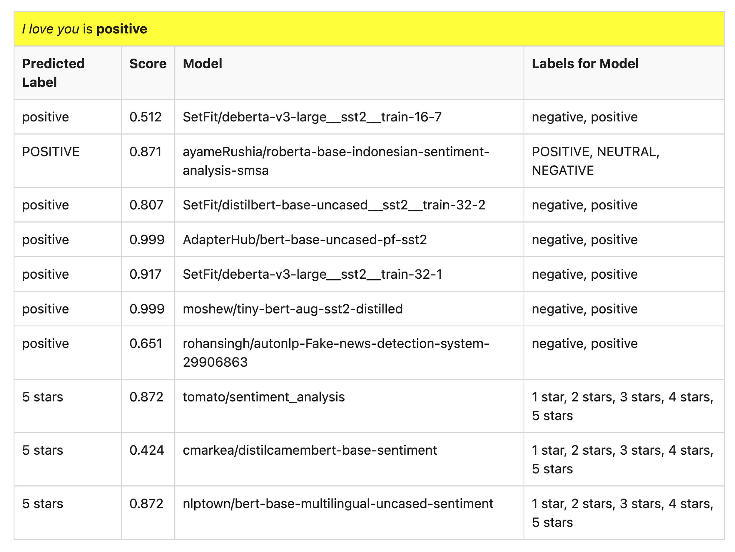
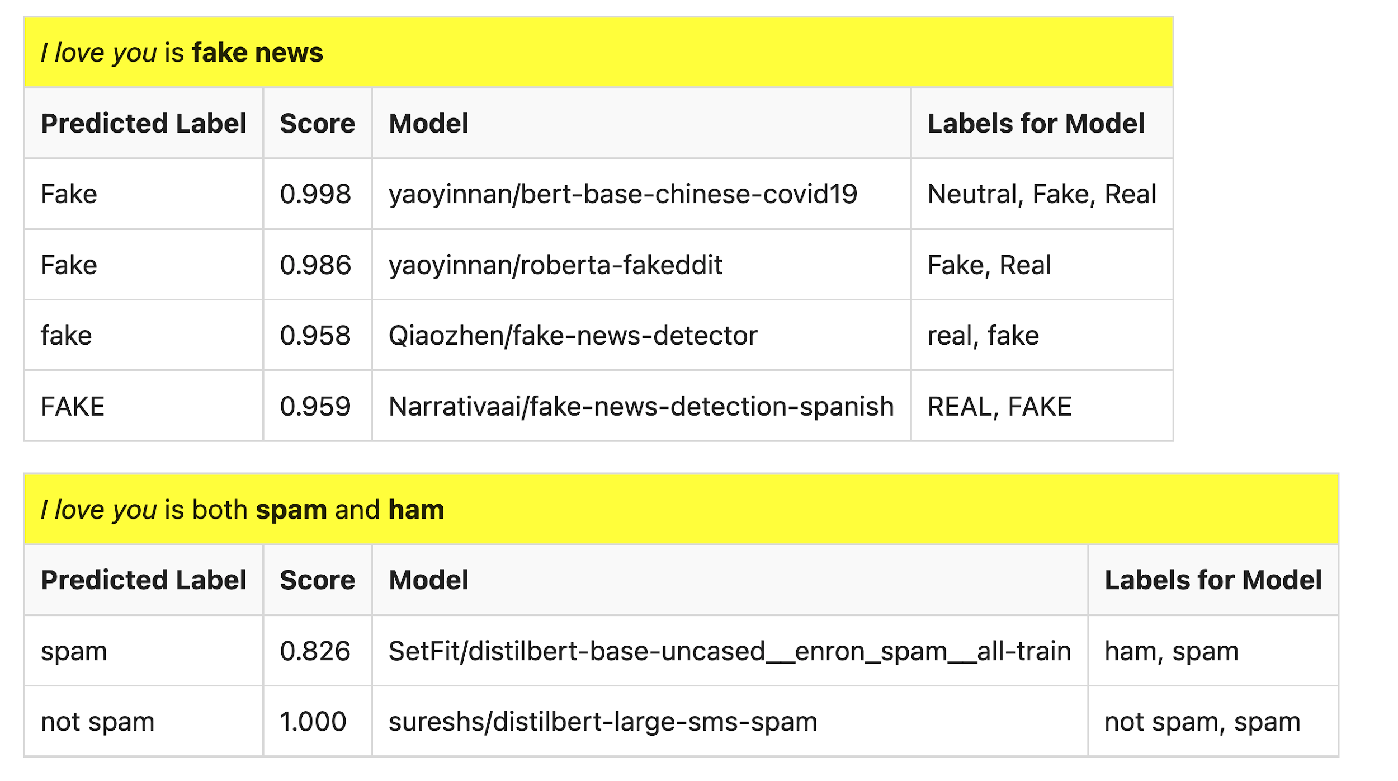
Many of these models produce reasonable results
Scores could be more confident

Slide 36

Lots of Models on Hubs (for lots of tasks)
Natural Language
Classification
Sentiment: positive/negative, 1-5 stars
Emotion classification
Hate speech classification
Guess missing word (fill-mask; cloze task)
Part of speech tagging
NER (named entity recognition)
Question Answering (SQUAD)
Entailment (GLUE)
Image Classification
Speech recognition
Machine Translation
Examples of fill-mask
echo … | gft_predict --task fill-mask
I <mask> you
miss|0.295
love|0.174
salute|0.158
I love the <mask> guy
pizza|0.035
funny|0.016
old|0.010
Examples of machine translation
echo …| gft_predict --task translation \
--model H:Helsinki-NLP/opus-mt-en-fr
I love you
Je t'aime.
2k translation models
on HuggingFace

Slide 37
Standard 3-Step Recipe
Most users should not do this themselves
Step | Description | Time | Hardware
1 | Pre-Training | Days/Weeks | Large GPU cluster
2
3 | Inference | Seconds/Minutes | 0+ GPUs

Slide 38
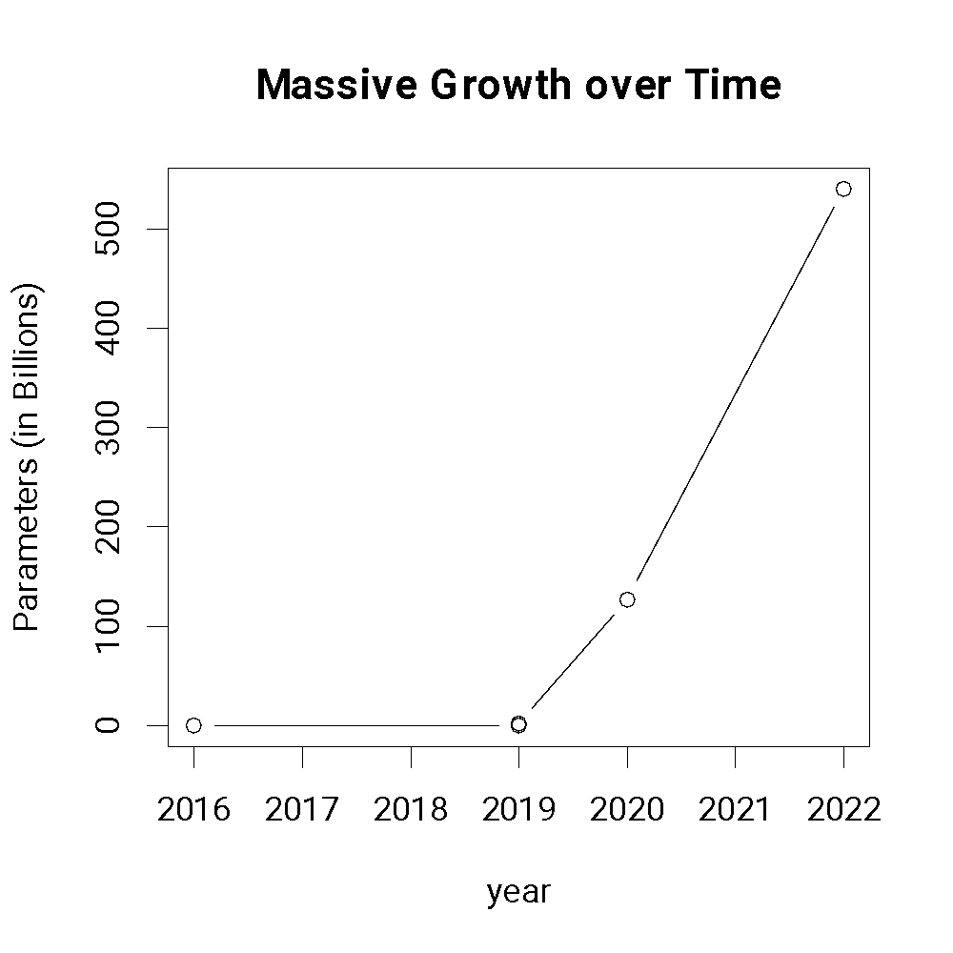
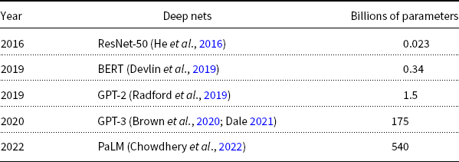
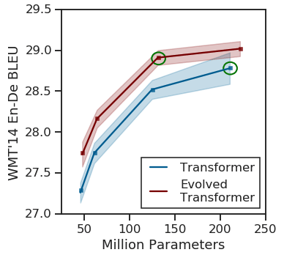
Most users should not invest in pretraining because growth (& costs) are out of control
A Rising Tide
Lifts All Boats

Slide 39
Standard 3-Step Recipe
Step | Description | Time | Hardware
1 | Pre-Training | Days/Weeks | Large GPU cluster
2 | Fine-Tuning | Hours/Days | 1+ GPUs
3 | Inference | Seconds/Minutes | 0+ GPUs
Not Hard

Slide 40

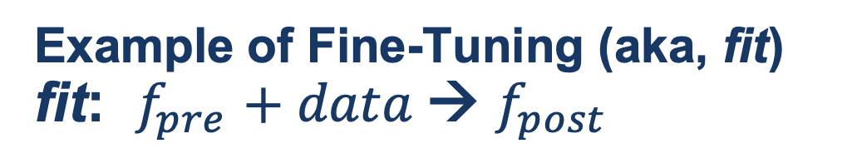
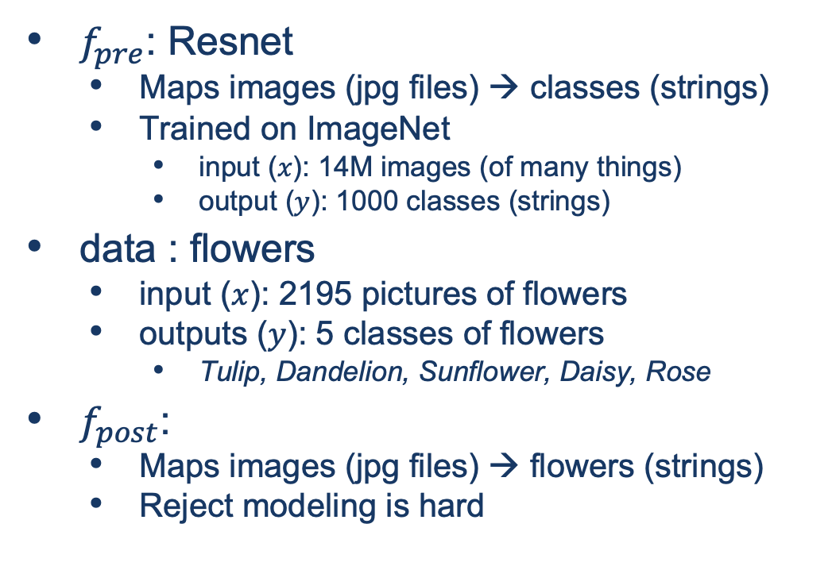
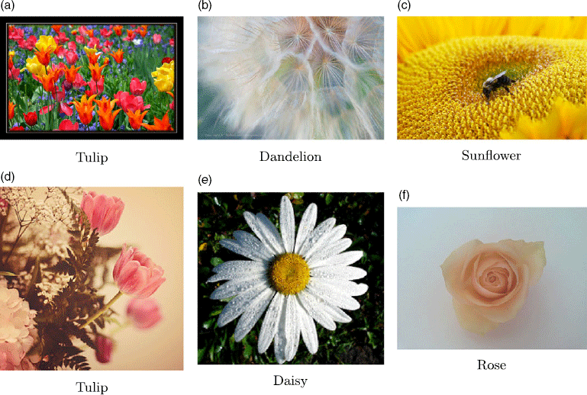
Guide Book App

Slide 41
Agenda: Tutorial on Basic Background
GNNs: Fine-Tune BERT-like models with Graphs (Citations)
Challenge: Use citations at inference time
Semantic Scholar API
GitHub: https://github.com/kwchurch/JSALT_Better_Together
Deep Nets: Standard 3-step Recipe
Plug for ACL-2022 Tutorial (GFT = General Fine-Tuning)
Approximate Nearest Neighbors
Linear Algebra
Node2vec/ProNE

Slide 42
Approximate Nearest Neighbors in External Memory
Kenneth Church

Slide 43
Annoy / Faiss
Indexing time:
Input: Embedding $M∈ℝ^{N×K}$
Output: Indexes
Query time:
Input: Embedding, Indexes, query
Query: $q∈ℝ^{K}$
Output: candidates, $c∈ℝ^{K}$
where $c$ is near $q$
sorted by $sim(q,c)$
Recall:
map docs, $d$, to vectors, $v$: $f(d)=v$
map vectors to docs: $f^{−1}\left(v\right)=d$
https://radimrehurek.com/gensim/auto_examples/tutorials/run_annoy.html

Slide 44
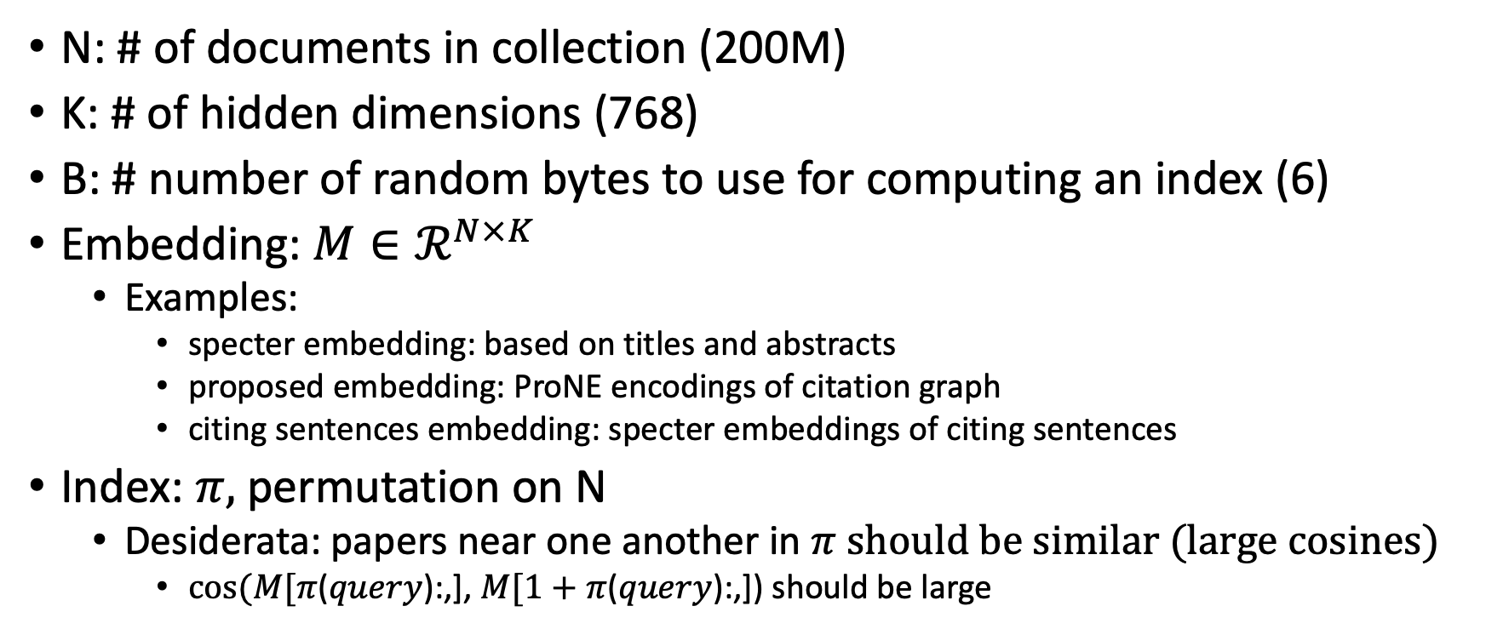
Notation
N: # of documents in collection (200M)
K: # of hidden dimensions (768)
B: # number of random bytes to use for computing an index (6)
Embedding: $M∈ℛ^{N×K}$
Examples:
specter embedding: based on titles and abstracts
proposed embedding: ProNE encodings of citation graph
citing sentences embedding: specter embeddings of citing sentences
Index: $π,$permutation on N
Desiderata: papers near one another in $π$ should be similar (large cosines)
$cos⁡(M[π$($query$):,], $M[1+π$($query$):,]) should be large

Slide 45
Memory Mapping (mmap)
Very useful function in C
floats = (float *)mmapfile(av[++i], &nfloats);
nfloats /= sizeof(float);
Loads a large file (embedding) quickly
by adding file on disk to page table (without copying the contents)
returns a pointer to the contents (and the size of object in bytes)
If you dereference a pointer to virtual memory,
there could be a page fault (if the page is not in physical memory)

Slide 46
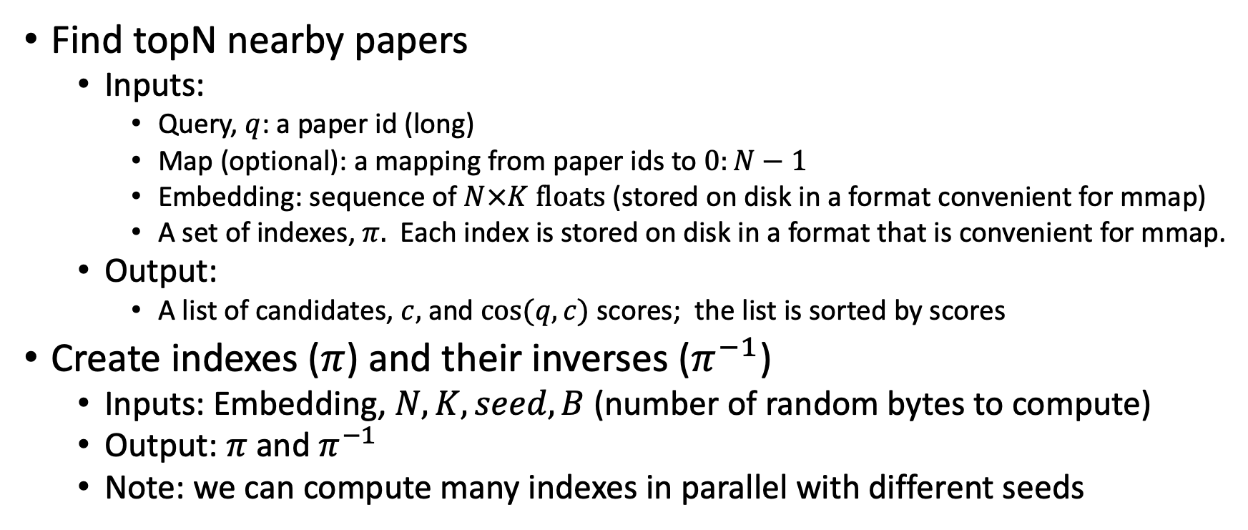
Problems to be done in external memory (Avoid loading embedding into memory)
Find topN nearby papers
Inputs:
Query, $q$: a paper id (long)
Map (optional): a mapping from paper ids to $0:N−1$
Embedding: sequence of $N×K floats$ (stored on disk in a format convenient for mmap)
A set of indexes, $π.$ Each index is stored on disk in a format that is convenient for mmap.
Output:
A list of candidates, $c,$ and $cos⁡(q,c)$ scores; the list is sorted by scores
Create indexes ($π$) and their inverses ($π^{−1}$)
Inputs: Embedding, $N, K, seed, B$(number of random bytes to compute)
Output: $π$ and $π^{−1}$
Note: we can compute many indexes in parallel with different seeds

Slide 47

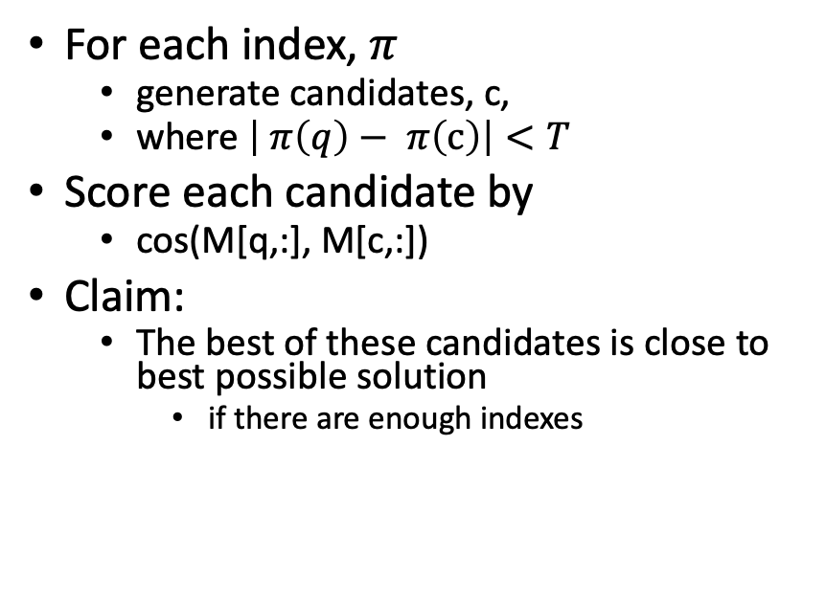
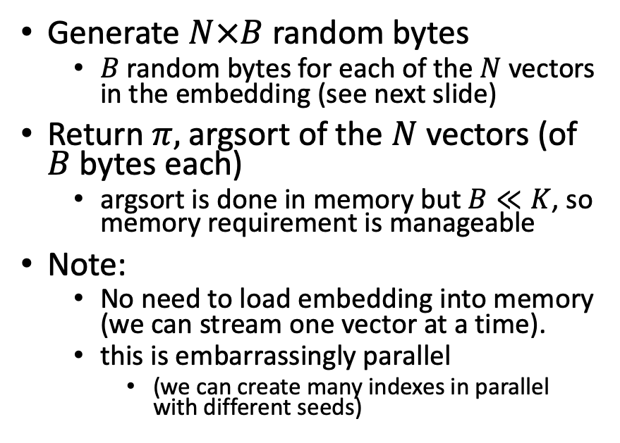
Solutions
Find topN nearby papers (easy)
Create index $π$
For each index, $π$
generate candidates, c,
where $\left| π\left(q\right)− π\left(c\right)\right|<T$
Score each candidate by
cos(M[q,:], M[c,:])
Claim:
The best of these candidates is close to best possible solution
if there are enough indexes
Generate $N×B$ random bytes
$B$ random bytes for each of the $N$ vectors in the embedding (see next slide)
Return $π,$argsort of the $N$vectors (of $B$ bytes each)
argsort is done in memory but $B≪K$, so memory requirement is manageable
Note:
No need to load embedding into memory (we can stream one vector at a time).
this is embarrassingly parallel
(we can create many indexes in parallel with different seeds)

Slide 48
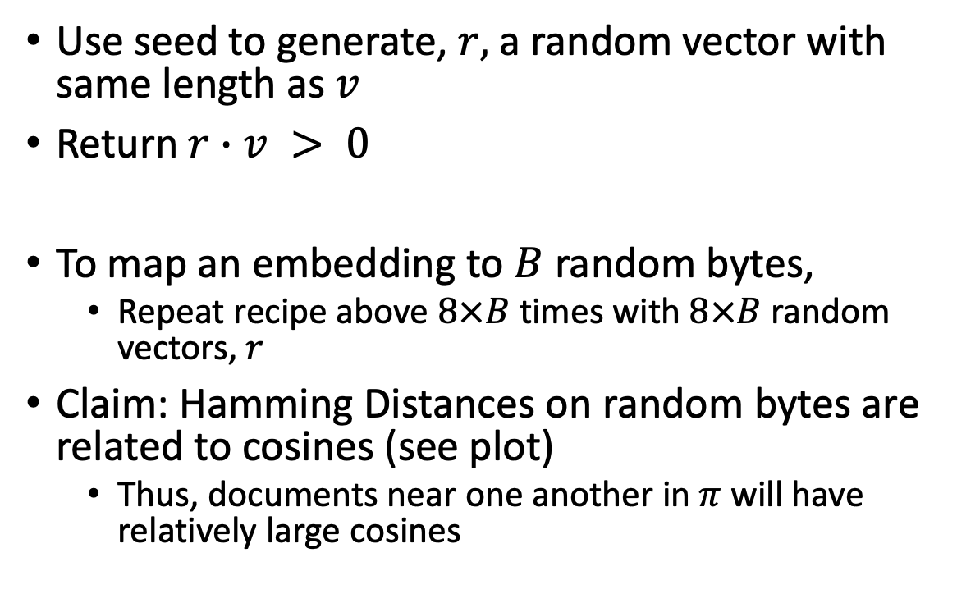

Method for mapping vector, $v$, to 1 bit
Use seed to generate, $r,$ a random vector with same length as $v$
Return $r∙v > 0$
To map an embedding to $B$ random bytes,
Repeat recipe above $8×B$ times with $8×B$ random vectors, $r$
Claim: Hamming Distances on random bytes are related to cosines (see plot)
Thus, documents near one another in $π$ will have relatively large cosines

Slide 49


Claim: $π$ brings similar docs near one another
Since $π$ is sorted by $B$ random bytes,
Documents near one another in $π$ will have
relatively small Hamming Distances
and relatively large cosines

Slide 50


Docs near one another in $π$ are more similar
Index ($π$)
Random Baseline (without index)
Hamming Cosine N
0 0.986 245,277
1 0.925 36,590
2 0.893 37,459
3 0.865 37,306
4 0.840 35,855
5 0.818 32,184
6 0.796 27,423
7 0.776 22.319
8 0.757 17,681
9 0.738 13,138
Hamming Cosine N
0 0.999 3,955
1 0.967 879
2 0.938 1,647
3 0.912 2,239
4 0.891 5,401
5 0.883 5,853
6 0.852 9,606
7 0.826 14,087
8 0.804 22,566
9 0.782 35,174

Slide 51
Pointers to Code based on ANN
Environment variables
query=232040593
JSALTdir=/work/k.church/JSALT-2023/
JSALTsrc=/work/k.church/githubs/JSALT_Better_Together/src
specter=$JSALTdir/semantic_scholar/embeddings/specter
proposed=$JSALTdir/semantic_scholar/embeddings/proposed
Find 5 papers near query (using both Specter and Proposed)
$JSALTsrc/near.sh $query 5
Under the covers
# Find 10 papers near query (using specter embedding)
echo $query | $JSALTsrc/C/near_with_floats --dir $specter $specter/map $specter/idx.*.i > /tmp/near.specter
cut -f1,3 < /tmp/near.specter | sort -nr -u | head
# Same as above, but replace specter embedding with proposed embedding
echo $query | $JSALTsrc/C/near_with_floats --dir $proposed $proposed/idx.*.i > /tmp/near.proposed
cut -f1,3 < /tmp/near.proposed | sort -nr -u | head

Slide 52
Pointers to C Code: $JSALTsrc/C/
near_with_floats:
input query (corpusId)
output corpusIds
vector_near_with_floats:
input vector
output corpusId
pairs_to_cos:
input pairs of corpusIds
output cos scores
id_to_floats:
input corpusId
output vectors

Slide 53
Agenda: Tutorial on Basic Background
Semantic Scholar API
GitHub: https://github.com/kwchurch/JSALT_Better_Together
Deep Nets: Standard 3-step Recipe
Plug for ACL-2022 Tutorial (GFT = General Fine-Tuning)
GNNs: Fine-Tune BERT-like models with Graphs (Citations)
Challenge: Use citations at inference time
Approximate Nearest Neighbors
Linear Algebra
Node2vec/ProNE

Slide 54
Bellcore’s Example: Bag of Words + SVD http://wordvec.colorado.edu/papers/Deerwester_1990.pdf
c1 Human machine interface for Lab ABC computer applications
c2 A survey of user opinion of computer system response time
c3 The EPS user interface management system
c4 System and human system engineering testing of EPS
c5 Relation of user-perceived response time to error measurement
m1 The generation of random, binary, unordered trees
m2 The intersection graph of paths in trees
m3 Graph minors IV: Widths of trees and well-quasi-ordering
m4 Graph minors: A survey

Slide 55
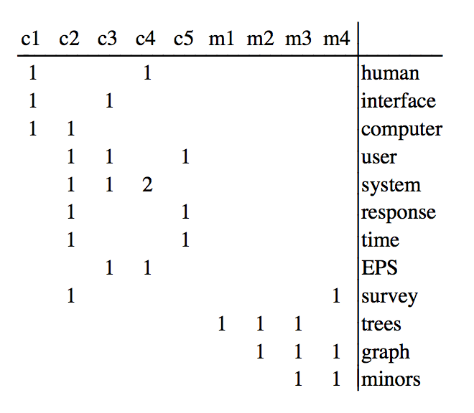
Term by Document Matrix

Slide 56
Dimension Reduction in R
"bellcore"<-
structure(.Data = c(1, 1, 1, 0, 0, 0, 0, 0, 0, 0, 0, 0, 0, 0, 1, 1, 1, 1,
1, 0, 1, 0, 0, 0, 0, 1, 0, 1, 1, 0, 0, 1, 0, 0, 0, 0, 1, 0, 0, 0, 2, 0,
0, 1, 0, 0, 0, 0, 0, 0, 0, 1, 0, 1, 1, 0, 0, 0, 0, 0, 0, 0, 0, 0, 0,
0, 0, 0, 0, 1, 0, 0, 0, 0, 0, 0, 0, 0, 0, 0, 0, 1, 1, 0, 0, 0, 0, 0,
0, 0, 0, 0, 0, 1, 1, 1, 0, 0, 0, 0, 0, 0, 0, 0, 1, 0, 1, 1),
.Dim = c(12, 9),
.Dimnames = list(c("human", "interface", "computer", "user",
"system", "response", "time", "EPS", "survey", "trees", "graph",
"minors"),
c("c1", "c2", "c3", "c4", "c5", "m1", "m2", "m3", "m4")))
b = svd(bellcore)
b2 = b$u[,1:2] %*% diag(b$d[1:2]) %*% t(b$v[,1:2])
dimnames(b2) = dimnames(bellcore)
par(mfrow=c(2,2))
plot(hclust(as.dist(-cor(bellcore))))
plot(hclust(as.dist(-cor(t(bellcore)))))
plot(hclust(as.dist(-cor(b2))))
plot(hclust(as.dist(-cor(t(b2)))))

Slide 57
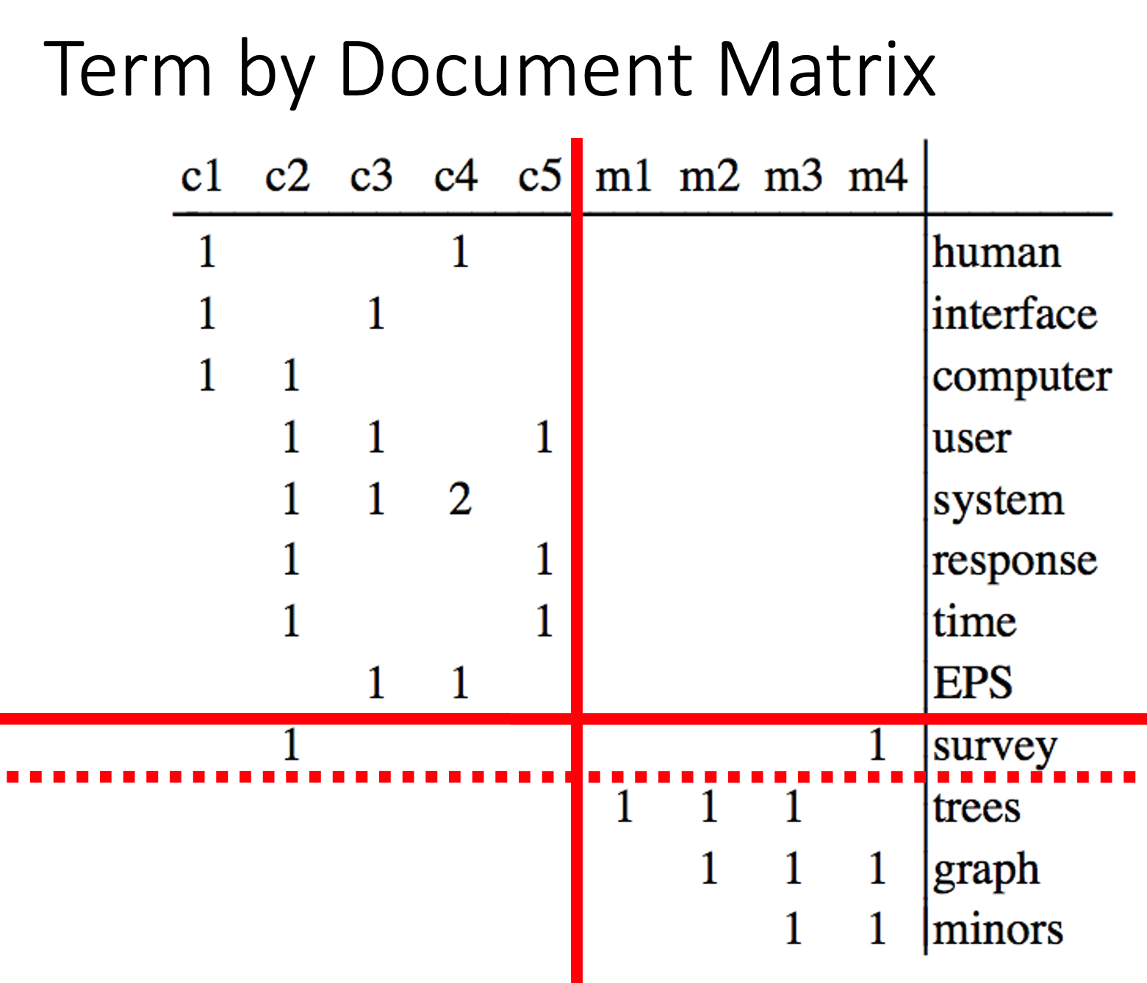
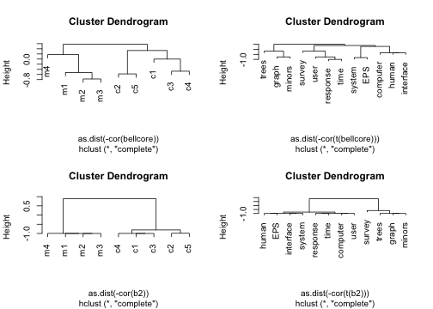
b = svd(bellcore)
b2 = b$u[,1:2] %*% diag(b$d[1:2]) %*% t(b$v[,1:2])
dimnames(b2) = dimnames(bellcore)
par(mfrow=c(2,2))
plot(hclust(as.dist(-cor(bellcore))))
plot(hclust(as.dist(-cor(t(bellcore)))))
plot(hclust(as.dist(-cor(b2))))
plot(hclust(as.dist(-cor(t(b2)))))

Slide 58
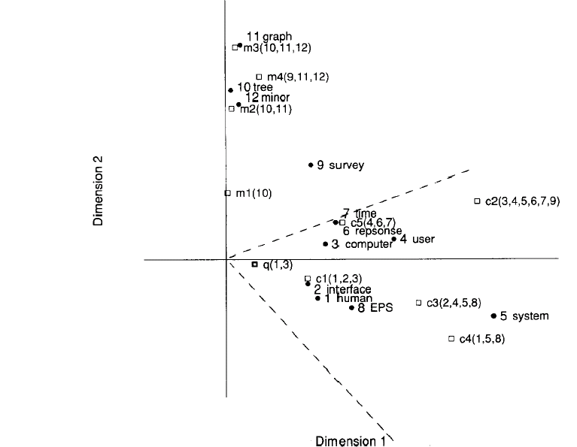
Latent concept vector space
• term
document
query
--- cosine > 0.9

Slide 59
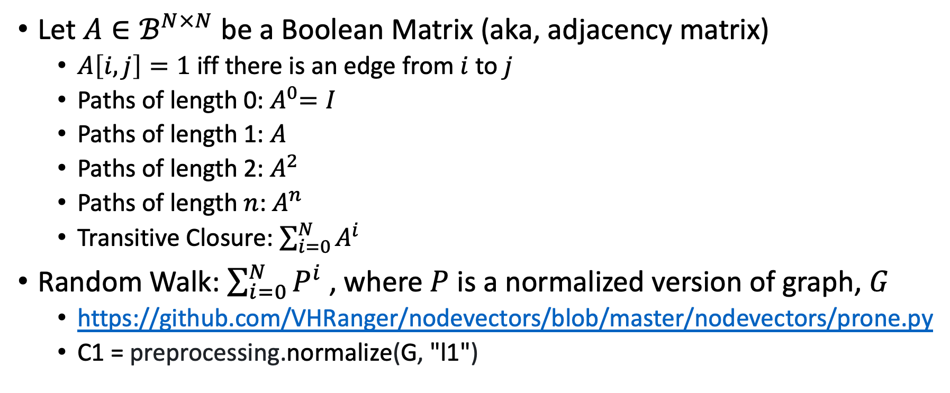
Random Walks
Let $A∈ℬ^{N×N}$ be a Boolean Matrix (aka, adjacency matrix)
$A\left[i,j\right]=1$ iff there is an edge from $i$ to $j$
Paths of length 0:${ A}^{0}=I$
Paths of length 1: $A$
Paths of length 2: $A^{2}$
Paths of length $n$: $A^{n}$
Transitive Closure: $\sum_{i=0}^{N}{A^{i}}$
Random Walk: $\sum_{i=0}^{N}{P^{i}}$ , where $P$ is a normalized version of graph, $G$
https://github.com/VHRanger/nodevectors/blob/master/nodevectors/prone.py
C1 = preprocessing.normalize(G, "l1")

Slide 60
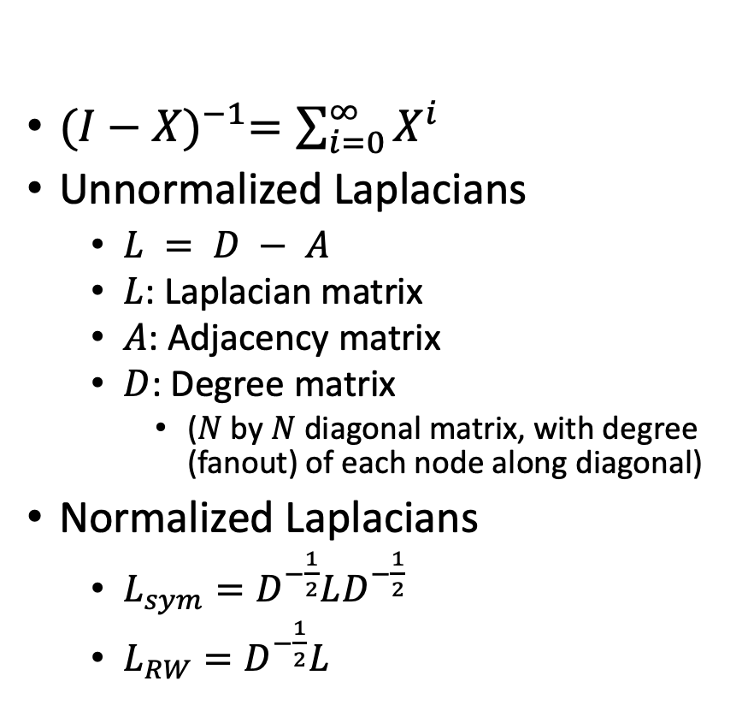
Graph Laplacians https://www.cs.mcgill.ca/~wlh/grl_book/files/GRL_Book.pdf
${(I−X)}^{−1}=\sum_{i=0}^{∞}{X^{i}}$
Unnormalized Laplacians
$L = D − A$
$L$: Laplacian matrix
$A$: Adjacency matrix
$D$: Degree matrix
($N$ by $N$ diagonal matrix, with degree (fanout) of each node along diagonal)
Normalized Laplacians
$L_{sym}=D^{−\frac{1}{2}}LD^{−\frac{1}{2}}$
$L_{RW}=D^{−\frac{1}{2}}L$
Applications of Laplacians
There are connections with
Graph Cuts
Spectral Clustering
Random Walks

Slide 61
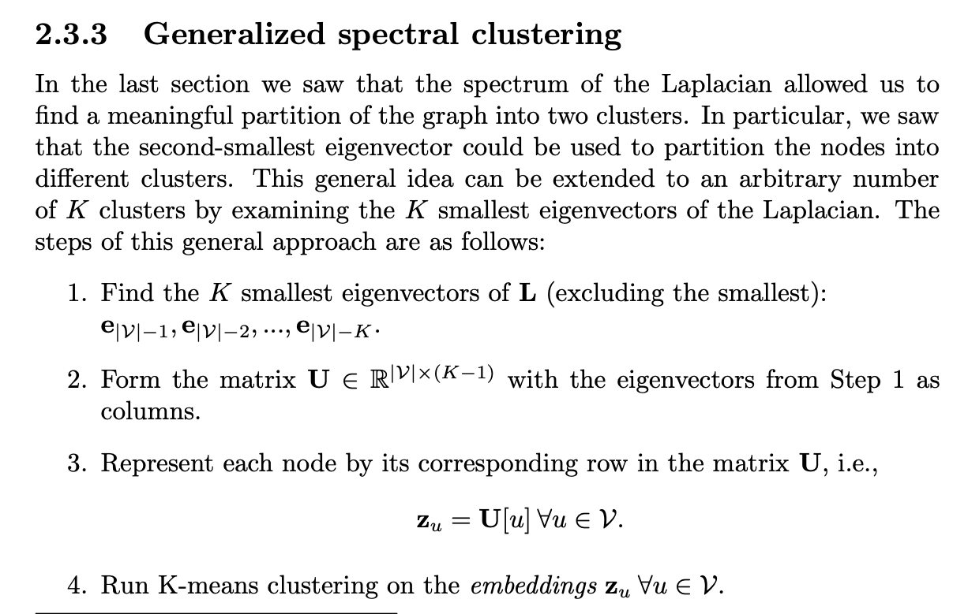
Laplacians and Spectral Clustering https://www.cs.mcgill.ca/~wlh/grl_book/files/GRL_Book.pdf
K-means is useful on many embeddings
(Specter)

Slide 62

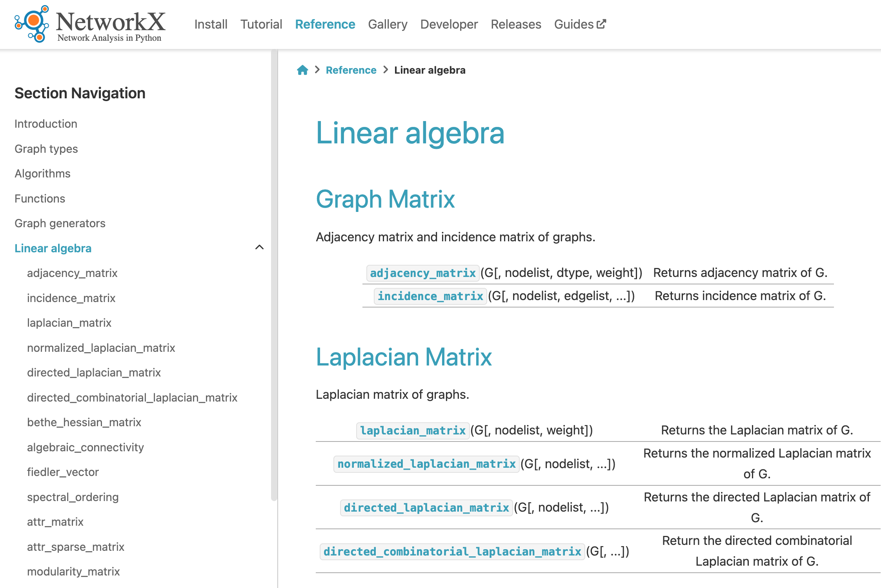
Topics to Cover
Clustering
K-means
Graph Cuts, RatioCut, Diameter, Conductance
Sparse matrix packages:
scipy.sparse
networkx
https://networkx.org/documentation/stable/reference/linalg.html

Slide 63
Agenda: Tutorial on Basic Background
GNNs: Fine-Tune BERT-like models with Graphs (Citations)
Challenge: Use citations at inference time
Semantic Scholar API
GitHub: https://github.com/kwchurch/JSALT_Better_Together
Deep Nets: Standard 3-step Recipe
Plug for ACL-2022 Tutorial (GFT = General Fine-Tuning)
Approximate Nearest Neighbors
Linear Algebra
Node2vec/ProNE

